Slide 1



Noida Institute of Engineering and Technology, Greater Noida
PREDICTIVE ANALYTICS
Unit: 1
LINEAR REGRESSION
Mr. Sovers Singh Bisht
Assistant Professor
DS-DEPT
NIET
B-Tech 5TH Sem
ONLINE & Offline (Sec A, B)

Slide 2


Noida Institute of Engineering and Technology, Greater Noida
Mr. Sovers Singh Bisht
Dep. HOD (Data Science)
B.Tech, M.Tech
PH.D (P) in CSE ..
Area of Expertise: Data Science, Big Data Analytics
& Cloud Computing.

Slide 3
Evaluation Scheme
PROGRAM ELECTIVES BUCKET
DS
 | Data Analytics | Full Stack Development | Mobility Management | CRM-RPA
Program Elective 1 | Predictive Analytics | Python Web Development with Django | Mobile Application Development | CRM Fundamentals
Program Elective 2 | Web Technologies | Design Patterns | Development in Swift Fundamentals | CRM Administration
Program Elective 3 | Programming for Data Analytics | Advanced Java Programming | Development in Swift Explorations and Data Collections | CRM Development
Program Elective 4 | Social Media Analytics | Web Development using MEAN Stack | Augmented Reality and Virtual Reality | Robotics Process Automation (RPA)
Program Elective 5 | Natural language Processing | Web Development using MERN Stack | Game Programming | Robotics Process Automation (RPA) Implementation

Slide 4
Evaluation Scheme
DATA ANALYTICS (AI/AIML)
SUBJECTS | CREDITS | ELECTIVE | SEMESTER
Predictive Analytics | 3 | I | 5th
Web Technologies | 3 | II | 5th
Programming for Data Analytics | 3 | III | 6th
Social Media Analytics | 3 | IV | 6th
Natural language Processing | 3 | V | 7th

Slide 5
Job Roles Defined Semester Wise – CSE (DS)
Concept Learning Task
 | Job Roles | Skill Set | Average Pay in India
Semester 01
Semester 02 | C Developer, CNC Programmer, Business Analyst | C , Python, SQL, MS Office, Storytelling, conscious listening, Power BI | INR 642,380
Semester 03 | Java Developer, Data Analyst | Core Java, Python, R, Advanced Excel | INR 442,380
Semester 04 | Data Base Engineer, ML Engineer, Data Analyst, Data Statistician, Data Base Administrator (NOSQL-Cassandra, MongoDB) | SQL, PL/SQL, Oracle, Python, R, MongoDB, Cassandra, Sqlite3 | INR 518,935
Semester 05 | Networks Engineer, Web Developer, Android Developer, Software Engineer, Any Analyst, Java Developer | CCNA, MEAR, MEAN Stack, Django, Predictive Analytics | INR 682,476
Semester 06 | Big Data Engineer, Data Engineer, Data Scientist, Data Specialist, Marketing Specialist, BI analyst | Big Data Processing Architecture, Python, R, SQL, SCALA and Pyspark | INR 830,088
Semester 07 | Data Scientist, Data Architect | Programming skills (SAS, R, Python), Statistical and Mathematical Skills, Storytelling And Data Visualization, Hadoop, SQL, machine learning, Predictive Modeling, (Python, Java, C++), Hadoop technologies, like MapReduce, Hive, and Pig, ETL (extract, transform, load), Data modeling (Impala, Oozie, Mahout, Flume) | INR 1,983,996
Semester 08 | NLP Developer | NLP techniques, Python, Java and R | INR 8,00,000

Slide 6
LIST OF 100 UNICORNS– CSE (DS)
The Concept Learning Task
1 | BYJU'S | 21 | Grofers | 41 | Pine Labs | 61 | BharatPe | 81 | Stellapps
2 | Paytm | 22 | FreeCharge | 42 | Moglix | 62 | PharmEasy | 82 | DailyNinja
3 | OYO Rooms | 23 | Practo | 43 | CitiusTech | 63 | Toppr | 83 | BlackBuck
4 | Ola Cabs | 24 | Udaan | 44 | Moglix | 64 | MPL | 84 | Shuttl
5 | Zomato | 25 | Zerodha | 45 | Vedantu | 65 | CarWale | 85 | Acko
6 | Flipkart | 26 | Razorpay | 46 | ShareChat | 66 | Paytm Mall | 86 | Licious
7 | Swiggy | 27 | CarTrade | 47 | Shadowfax | 67 | Lensico | 87 | CredR
8 | Snapdeal | 28 | FirstCry | 48 | Nykaa | 68 | KreditBee | 88 | Vogo
9 | Hike | 29 | BlackBuck | 49 | OfBusiness | 69 | NoBroker | 89 | MyGate
10 | ShopClues | 30 | Postman | 50 | PhonePe | 70 | Sharekhan | 90 | LendingKart
11 | InMobi | 31 | Rupeek | 51 | Cars24 | 71 | Meesho | 91 | CARS24
12 | Quikr | 32 | Droom | 52 | InMobi | 72 | FarEye | 92 | Ather Energy
13 | Delhivery | 33 | CarDekho | 53 | Bounce | 73 | Spinny | 93 | Bizongo
14 | Dream11 | 34 | Icertis | 54 | Cred | 74 | Chargebee | 94 | Swiggy
15 | Freshworks | 35 | Swiggy | 55 | Eruditus | 75 | Vokal | 95 | Treebo
16 | MakeMyTrip | 36 | Ola Electric | 56 | Lendingkart | 76 | Quikr | 96 | Vedantu
17 | Lenskart | 37 | InCred | 57 | Innovaccer | 77 | OYO Workspaces | 97 | Zinier
18 | Rivigo | 38 | Rebel Foods | 58 | Zenoti | 78 | GreyOrange | 98 | Country Delight
19 | BigBasket | 39 | Unacademy | 59 | Locus | 79 | Uniphore | 99 | Bounce
20 | PolicyBazaar | 40 | Dailyhunt | 60 | Myntra | 80 | Druva | 100 | VerSe Inn

Slide 7
Evaluation Scheme
B.Tech. (Data Analytics-DS)
Elective- I
5th SEMESTER
PREDICTIVE ANALYTICS
L T P | Credits
3 – 0 – 0 | 3

Slide 8

Course Contents / Syllabus
B. TECH. THIRD YEAR (ELECTIVE-I)
Course code |  |  | L T P | Credits
Course title |  | PREDICTIVE ANALYTICS | 3 0 0 | 3
Course objective:
To be able to solve complex problems that require discovering hidden patterns in the data and a deep understanding of intricate relationships between a large number of interdependent variables tasked with collecting, analyzing, and interpreting large amounts of data.
Pre-requisites: Basic concepts of Machine learning Algorithms
Course Contents / Syllabus
UNIT-I | LINEAR REGRESSION |  |  | 8 HOURS
Introduction to Predictive Analytics, Regression basics: Relationship between attributes using Covariance and Correlation, Relationship, between multiple variables: Regression (Linear, Multivariate) in prediction, Residual Analysis Identifying significant features, feature reduction using AIC, multi-collinearity, Non-normality and Hetero scedasticity, Hypothesis testing of Regression Model, Confidence intervals of Slope, R-square and goodness of fit, Influential Observations – Leverage.
UNIT-II | MULTIPLE LINEAR REGRESSION |  |  | 8 HOURS
Polynomial Regression, Regularization methods, Lasso, Ridge and Elastic nets, Categorical Variables in Regression.
UNIT-III | NON-LINEAR REGRESSION |  |  | 8 HOURS
Logit function and interpretation, Types of error measures (ROCR), Logistic Regression in classification.

Slide 9
Course Contents / Syllabus
UNIT-IV |  | FORECASTING MODELS |  |  | 8 HOURS
Trend analysis, Cyclical and Seasonal analysis, smoothing, Moving averages, Box-Jenkins, Holt-winters, Autocorrelation, ARIMA, Examples: Applications of Time Series in financial markets.
UNIT-V |  | FEATURE ENGINEERING |  |  | 8 HOURS
Data Science Vs. Machine Learning, Exploratory Data Analysis, Feature Encoding, Imputation Feature Scaling, Determining correlation, Feature selection, Feature extraction.
Course outcome: After completion of this course students will be able to
CO 1 | Apply specific statistical and regression analysis methods applicable to predictive analytics to identify new trends and patterns, uncover relationships, create forecasts, predict likelihoods, and test predictive hypotheses. | Apply specific statistical and regression analysis methods applicable to predictive analytics to identify new trends and patterns, uncover relationships, create forecasts, predict likelihoods, and test predictive hypotheses. |  |  |  | K1, K2
CO 2 | Learn how to select the appropriate method for predictive analysis, and how to build effective predictive models. | Learn how to select the appropriate method for predictive analysis, and how to build effective predictive models. |  |  |  | K2
CO 3 | Learn how to evaluate the soundness, appropriateness and validity of their models and how to interpret and report on results for a management audience. | K3
CO 4 | Apply predictive analytics approaches on diverse business cases and scenarios. | K4
CO 5 | Understand the process of formulating business objectives, data selection/collection, preparation and process to successfully design, build, evaluate and implement predictive models for a various business application. | K5, K6

Slide 10
External Links as per Syllabus
a
Unit 1 | Predictive Analytics Tutorial | Linear Regression in Python | Logistic Regression | Great Learning - YouTube Multiple Regression Analysis: Hypothesis Tests - YouTube Mod-06 Lec-28 Goodness of Fit - YouTube
Unit 2 | Multiple Linear Regression Model - YouTube Regularization In Machine Learning | Regularization Example | Machine Learning Tutorial |Simplilearn - YouTube Implementing Ridge, Lasso and Elastic Net in Python from Scratch (Mathematics Explained!) - YouTube
Unit 3 | Non Linear Regression | Data Science | Econometrics - YouTube Machine Learning Tutorial Python - 8: Logistic Regression (Binary Classification) - YouTube
Unit 4 | Time Series Talk : ARIMA Model - YouTube Holt winters Model, Easiest Times series Model. Additive multiplicative trend and seasonality - YouTube Time Series Analysis in Python | Time Series Forecasting | Data Science with Python | Edureka - YouTube
Unit 5 | Data Science vs Machine Learning – What’s The Difference? | Data Science Course | Edureka - YouTube Exploratory Data Analysis (EDA) Using Python | Python Data Analysis | Python Training | Edureka - YouTube Feature Selection In Machine Learning | Feature Selection Techniques With Examples | Simplilearn - YouTube

Slide 11
Branch wise Applications
Predictive analytics is a branch of advanced analytics that makes predictions about future outcomes using historical data combined with statistical modeling, data mining techniques and machine learning. Companies employ predictive analytics to find patterns in this data to identify risks and opportunities.
Predictive analytics are used to determine customer responses or purchases, as well as promote cross-sell opportunities. Predictive models help businesses attract, retain and grow their most profitable customers. Improving operations. Many companies use predictive models to forecast inventory and manage resources.
Predictive analytics uses statistics and modeling techniques to determine future performance.
Industries and disciplines, such as insurance and marketing, use predictive techniques to make important decisions.
Predictive models help make weather forecasts, develop video games, translate voice-to-text messages, customer service decisions, and develop investment portfolios.
People often confuse predictive analytics with machine learning even though the two are different disciplines.
Types of predictive models include decision trees, regression, and neural networks.

Slide 12

Course Objective
The objective of this course is -
To be able to solve complex problems that require discovering hidden patterns in the data and a deep understanding of intricate relationships between a large number of interdependent variables tasked with collecting, analyzing, and interpreting large amounts of data.

Slide 13
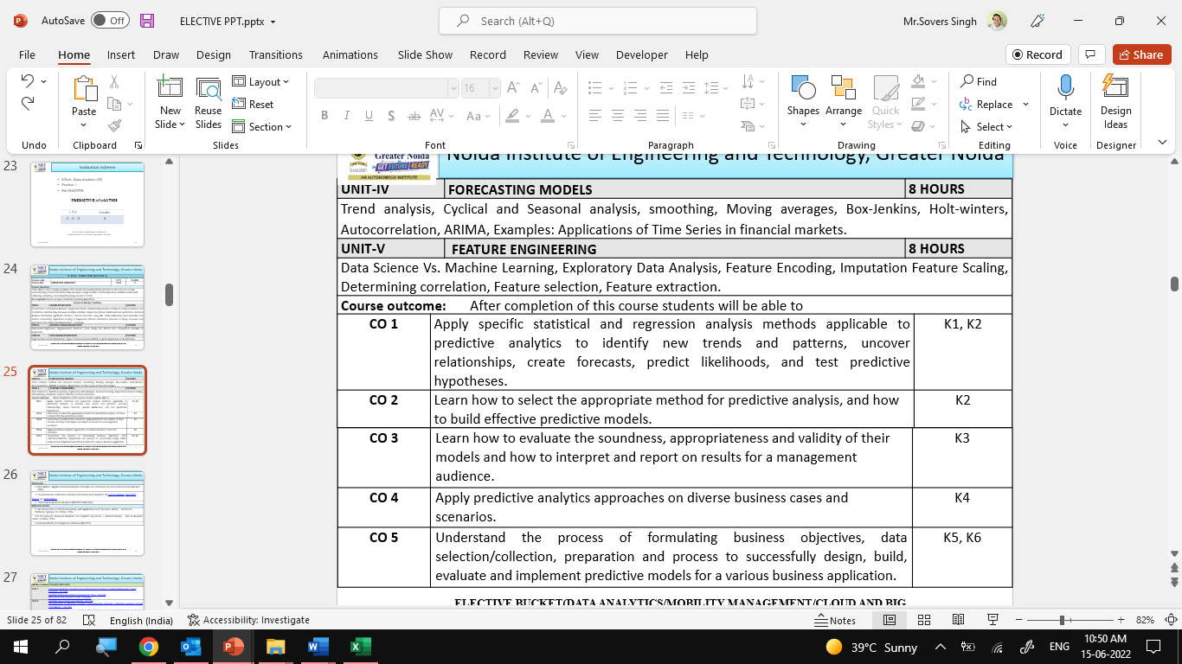

Course Outcomes

Slide 14
Program Outcomes
Engineering Graduates will be able to Understand:
1. Engineering knowledge
2. Problem analysis
3. Design/development of solutions
4. Conduct investigations of complex
5. Modern tool usage
6. The engineer and society
7. Environment and sustainability
8. Ethics
9. Individual and team work
10. Communication
11. Project management and finance
12. Life-long learning

Slide 15
CO-PO Mapping

Slide 16
Program Specific Outcomes (PSOs)
PSO’s
At the end of the program, the student will be able to-
PSO 1: Analyse, design and develop solutions by applying fundamental concepts of Data Science
PSO 2: Apply technical knowledge while using modern tools and technologies for solving complex problems.
PSO 3: Collaborate different fields of science and technology with right attitude, to work as an individual or as a team, demonstrating professional ethics for the well-being of society

Slide 17
COs and PSOs Mapping

Slide 18
Program Educational Objectives (PEOs)
PEO’s
The graduates of B.Tech Data Science program will-
PEO1: Solve real time complex problems and adapt to technological changes with the ability of lifelong learning.
PEO2: Work as data scientists ,entrepreneurs and bureaucrats for goodwill of the society and pursue higher education.
PEO3: Exhibit professional ethics and moral values with good leadership qualities and effective interpersonal skills

Slide 19
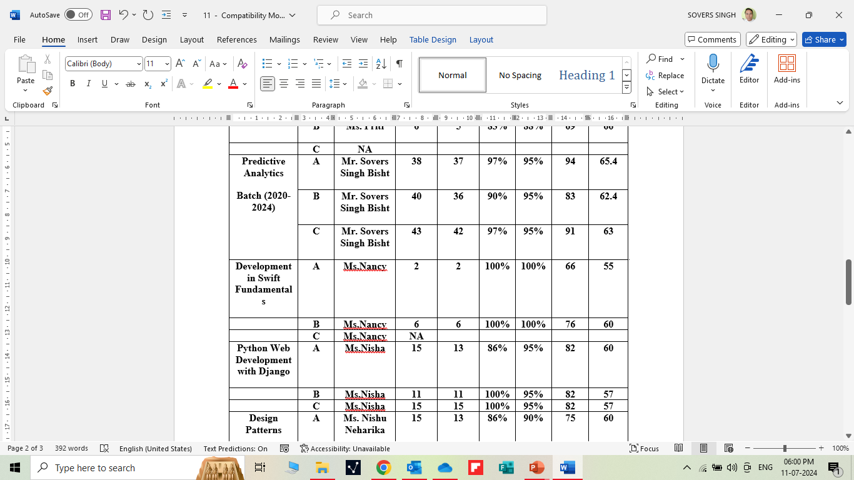
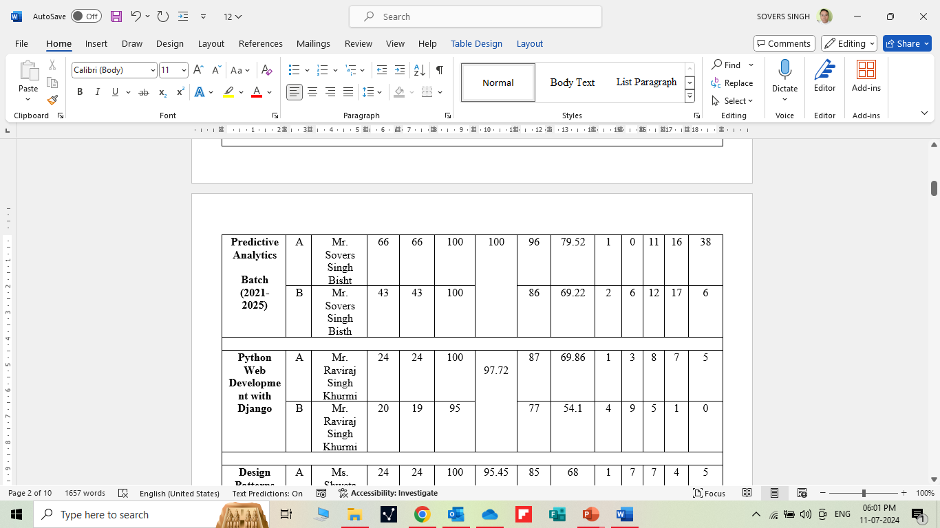
RESULT ANALYSIS

Slide 20
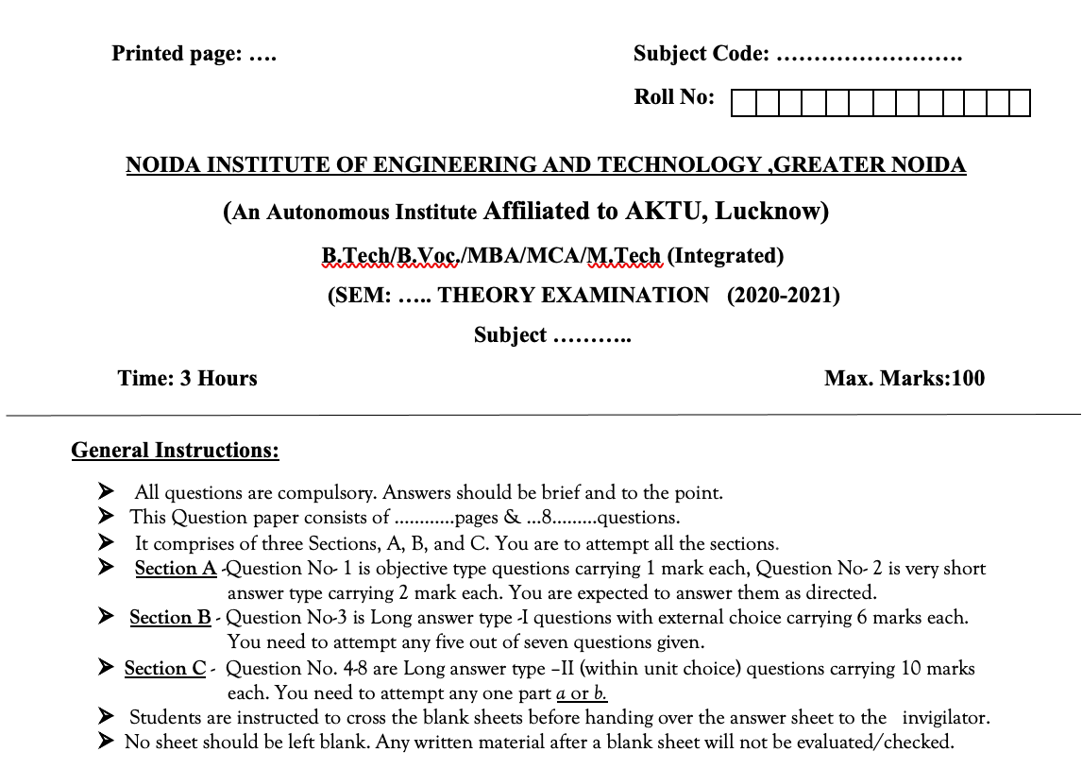
Question Paper Template

Slide 21
Question Paper Template
 |  | SECTION – A |  | CO
 | Attempt all parts- |  | [10×1=10]
 | 1-a. | Question- | (1)
 | 1-b. | Question- | (1)
 | 1-c. | Question- | (1)
 | 1-d. | Question- | (1)
 | 1-e. | Question- | (1)
 | 1-f. | Question- | (1)
 | 1-g. | Question- | (1)
 | 1-h. | Question- | (1)
 | 1-i. | Question- | (1)
 | 1-j. | Question- | (1)
2. | Attempt all parts- |  | [5×2=10] | CO
 | 2-a. | Question- | (2)
 | 2-b. | Question- | (2)
 | 2-c. | Question- | (2)
 | 2-d. | Question- | (2)
 | 2-e. | Question- | (2)
SECTION – B |  |  |  | CO
3. | Answer any five of the following- |  | [5×6=30]
 | 3-a. | Question- | (6)
 | 3-b. | Question- | (6)
 | 3-c. | Question- | (6)
 | 3-d. | Question- | (6)
 | 3-e. | Question- | (6)
 | 3-f. | Question- | (6)
 | 3-g. | Question- | (6)
SECTION – C |  |  |  | CO
4 | Answer any one of the following- |  | [5×10=50]
 | 4-a. | Question- | (10)
 | 4-b. | Question- | (10)
5. | Answer any one of the following-
 | 5-a. | Question- | (10)
 | 5-b. | Question- | (10)
6. | Answer any one of the following-
 | 6-a. | Question- | (10)
 | 6-b. | Question- | (10)
7. | Answer any one of the following-
 | 7-a. | Question- | (10)
 | 7-b. | Question- | (10)
8. | Answer any one of the following-
 | 8-a. | Question- | (10)
 | 8-b. | Question- | (10)

Slide 22
Prerequisite and Recap
Prerequisites:
Linux/ Windows operating system.
Knowledge of basic descriptive statistics and machine learning.
Java & R Studio.
MS Office 2019 and Above.
Programming Languages (Python)
Recap:
Discussion about Data Science Environments.

Slide 23
Brief Intro of Subject with video
Predictive analytics is a form of technology that makes predictions about certain unknowns in the future. It draws on a series of techniques to make these determinations, including artificial intelligence (AI), data mining, machine learning, modeling, and statistics.
For instance, data mining involves the analysis of large sets of data to detect patterns from it. Text analysis does the same, except for large blocks of text.
Predictive models are used for all kinds of applications, including:
Weather forecasts
Creating video games
Translating voice to text for mobile phone messaging
Customer service
Investment portfolio development
https://www.youtube.com/watch?v=4y6fUC56KPw
https://www.youtube.com/watch?v=JOArz7wggkQ

Slide 24
The Concept Learning Task
Linear Regression:
Regression basics: Relationship between attributes using Covariance and Correlation
Relationship between multiple variables: Regression (Linear, Multivariate) in prediction
Residual Analysis Identifying significant features
Feature reduction using AIC, multi-collinearity
Non-normality and Hetero scedasticity
Hypothesis testing of Regression Model
Confidence intervals of Slope, R-square and goodness of fit
Influential Observations – Leverage.

Slide 25
Unit Objective
The objective of the Unit 1 is :
1.To provide an overview of an exciting growing field of data science.
2. To inculcate the preliminary knowledge of handling data , discuss various statistical techniques for handling data.
3. Predictive analytics is a decision-making tool in a variety of industries.
4. Linear Regression is the model that is used the most in statistical analysis. Use it when you want to determine patterns in large sets of data and when there's a linear relationship between the inputs.

Slide 26
Regression basics: Relationship between attributes using Covariance and Correlation
Objective:
In this topic we learn about correlation which is a relationship between two variables. The amount of correlation, or relationship, can be explained in a numerical form called a correlation coefficient - defined as a numerical representation of the strength and direction of the relationship.
Recap:
Revision of basic statistical approaches.

Slide 27

Topic objective (CO1)
Correlation
Identify the direction and strength of a correlation between two factors.
Compute and interpret the Pearson correlation coefficient and test for significance.
Compute and interpret the coefficient of determination.
Compute and interpret the Spearman correlation coefficient and test for significance.

Slide 28
Correlation(CO1)
Correlation: In a bivariate distribution we are interested to find out i f there is any correlation between the two variables under study.
If the change in one variable affects a change in the other variable, the variables are said to be correlated.
Positive Correlation
If the two variables deviate in the same direction, i.e., if the increase (or decrease) in one results in a corresponding increase (or decrease) in the other, correlation is said to be direct or positive.
For example, the correlation between (i) the heights and weights of a group of persons, and (ii) the income and expenditure; is positive.

Slide 29
Correlation(CO1)
Negative Correlation:
If the two variables deviate in the opposite directions, i.e., if increase (or decrease) in one results in corresponding decrease (or increase) in the other, correlation is said to be diverse or negative.
For example, the correlation between (i) the price and demand of a commodity, and (ii) the volume and pressure of a perfect gas; is negative.
Perfect Correlation
Correlation is said to be perfect if the deviation in one variable is followed by a corresponding and proportional deviation in the other.

Slide 30
Correlation(CO1)
Scatter Diagram:
For the bivariate distribution (x_{i}, y_{i} ); i = 1, 2, ..., n, if the values of the variables X and Y are plotted along the x-axis and y-axis respectively in the x-y plane, the diagram of dots so obtained is known as scatter diagram.
It is the simplest way of the diagrammatic representation of bivariate data.
From the scatter diagram, we can form an idea whether the variables are correlated or not.
For example, if the points are very dense, i.e., very close to each other, a correlation is expected.
If the points are widely scattered, a poor correlation is expected.
This method, however, is not suitable if the number of observations is fairly large.

Slide 31
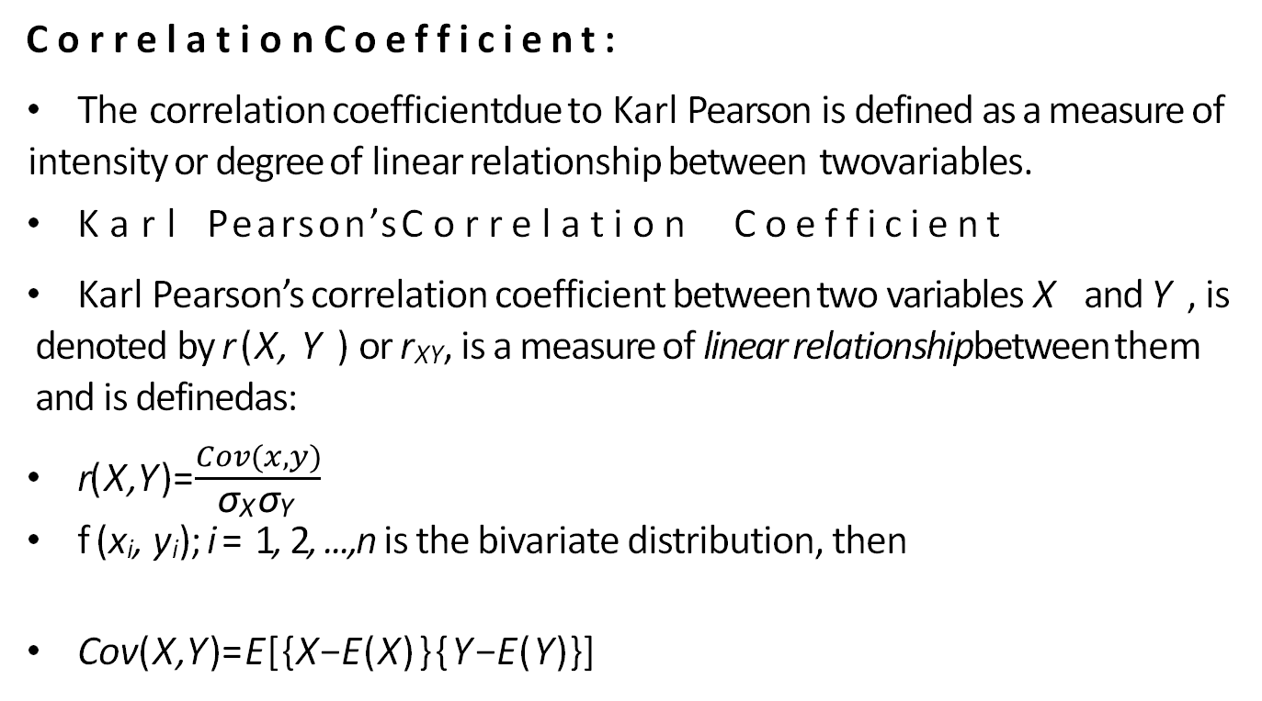
Correlation(CO1)
CorrelationCoefficient:
The correlation coefficientdue to Karl Pearson is defined as a measure of intensity or degree of linear relationship between twovariables.
Karl Pearson’sCorrelation Coefficient
Karl Pearson’s correlation coefficient between two variables X and Y , is denoted by r (X, Y ) or r_{XY}, is a measure of linear relationshipbetween them and is definedas:
r(X,Y)=$\frac{Cov(x,y)}{\text{σ}\text{X} \text{σ}\text{Y} }$
f (x_{i}, y_{i}); i = 1, 2, ...,n is the bivariate distribution, then
Cov(X,Y)=E[{X−E(X)}{Y−E(Y)}]

Slide 32
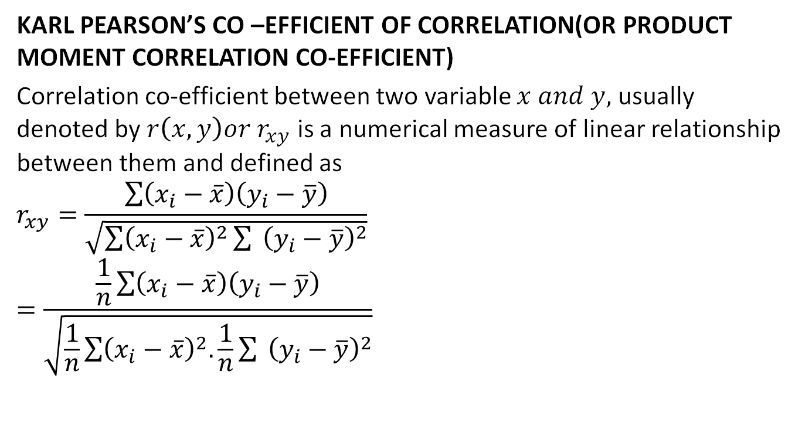
Correlation(CO1)
KARL PEARSON’S CO –EFFICIENT OF CORRELATION(OR PRODUCT MOMENT CORRELATION CO-EFFICIENT)
Correlation co-efficient between two variable $x and y,$ usually denoted by $r\left(x,y\right)or r_{xy}$ is a numerical measure of linear relationship between them and defined as
$$r_{xy}=\frac{\sum{\left(x_{i}−\overline{x}\right)\left(y_{i}−\overline{y}\right)}}{\sqrt{\sum{{\left(x_{i}−\overline{x}\right)}^{2}{\sum{ }\left(y_{i}−\overline{y}\right)}^{2}}}}$$
$$=\frac{\frac{1}{n}\sum{\left(x_{i}−\overline{x}\right)\left(y_{i}−\overline{y}\right)}}{\sqrt{\frac{1}{n}\sum{{\left(x_{i}−\overline{x}\right)}^{2}.\frac{1}{n}{\sum{ }\left(y_{i}−\overline{y}\right)}^{2}}}}$$

Slide 33
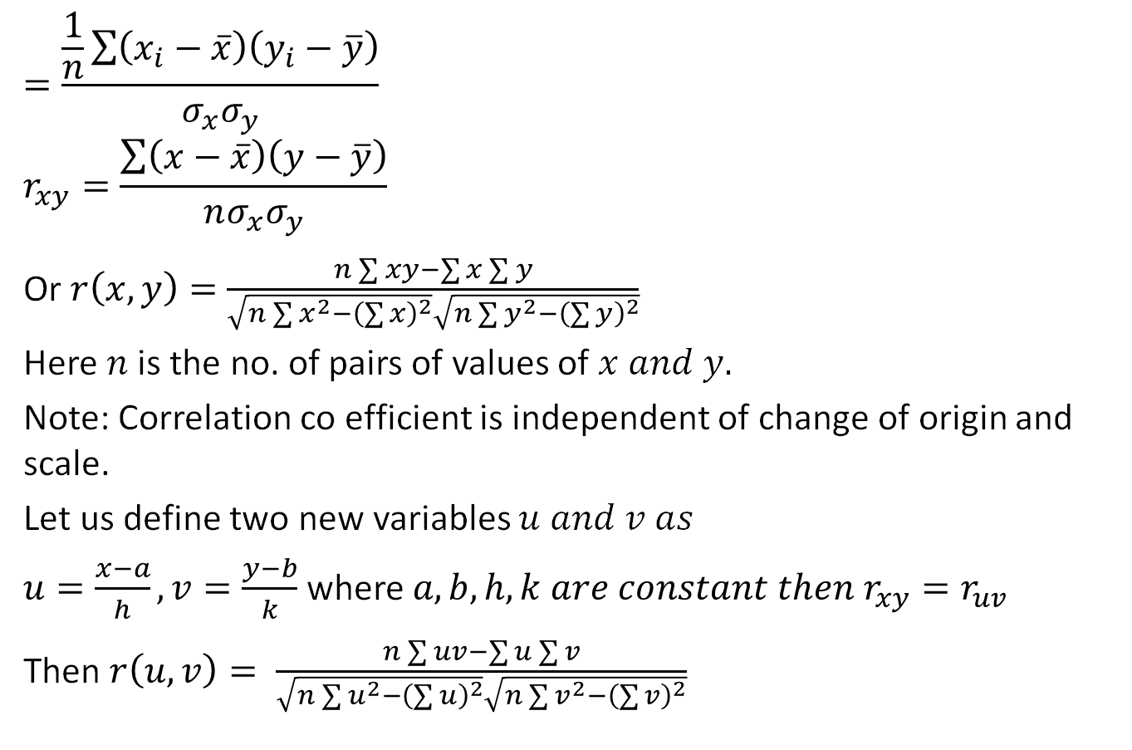
Correlation(CO1)
$$=\frac{\frac{1}{n}\sum{\left(x_{i}−\overline{x}\right)\left(y_{i}−\overline{y}\right)}}{σ_{x}σ_{y}}$$
$$r_{xy}=\frac{\sum{\left(x−\overline{x}\right)\left(y−\overline{y}\right)}}{nσ_{x}σ_{y}}$$
Or $r\left(x,y\right)=\frac{n\sum{xy}−\sum{x}\sum{y}}{\sqrt{n\sum{x^{2}−{\left(\sum{x}\right)}^{2}}}\sqrt{n\sum{y^{2}−{\left(\sum{y}\right)}^{2}}}}$
Here $n$is the no. of pairs of values of $x and y.$
Note: Correlation co efficient is independent of change of origin and scale.
Let us define two new variables $u and v as$
$u=\frac{x−a}{h},v=\frac{y−b}{k}$where $a,b,h,k are constant then r_{xy}=r_{uv}$
Then $r\left(u,v\right)= \frac{n\sum{uv}−\sum{u}\sum{v}}{\sqrt{n\sum{u^{2}−{\left(\sum{u}\right)}^{2}}}\sqrt{n\sum{v^{2}−{\left(\sum{v}\right)}^{2}}}}$

Slide 34
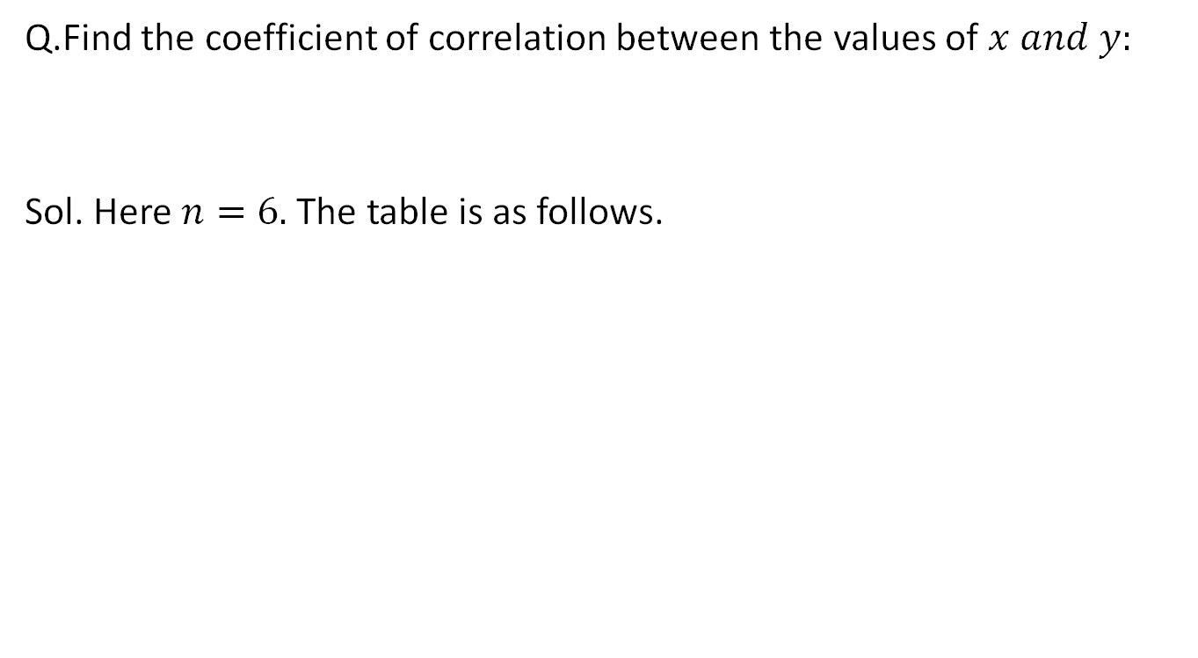
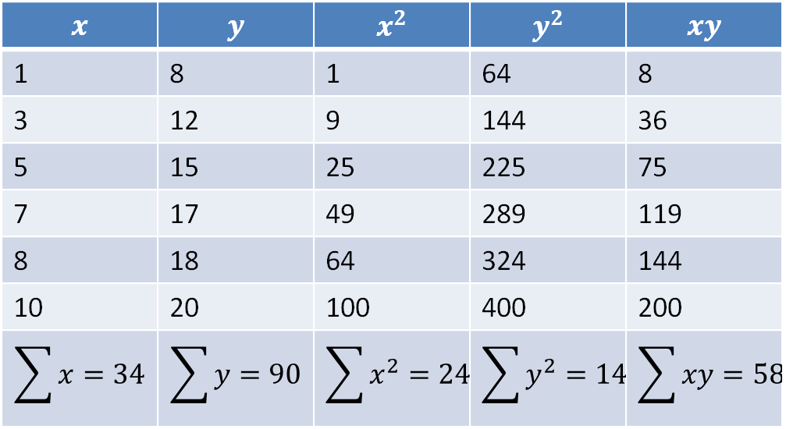
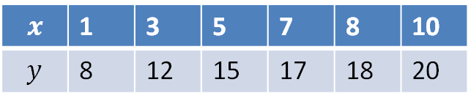
Correlation(CO1)
Q.Find the coefficient of correlation between the values of $x and y:$
Sol. Here $n=6.$ The table is as follows.
$$x$$ | 1 | 3 | 5 | 7 | 8 | 10
$$y$$ | 8 | 12 | 15 | 17 | 18 | 20
$$x$$ | $$y$$ | $$x^{2}$$ | $$y^{2}$$ | $$xy$$
1 | 8 | 1 | 64 | 8
3 | 12 | 9 | 144 | 36
5 | 15 | 25 | 225 | 75
7 | 17 | 49 | 289 | 119
8 | 18 | 64 | 324 | 144
10 | 20 | 100 | 400 | 200
$$\sum{x=34}$$ | $$\sum{y=90}$$ | $$\sum{x^{2}=248}$$ | $$\sum{y^{2}=1446}$$ | $$\sum{xy=582}$$

Slide 35
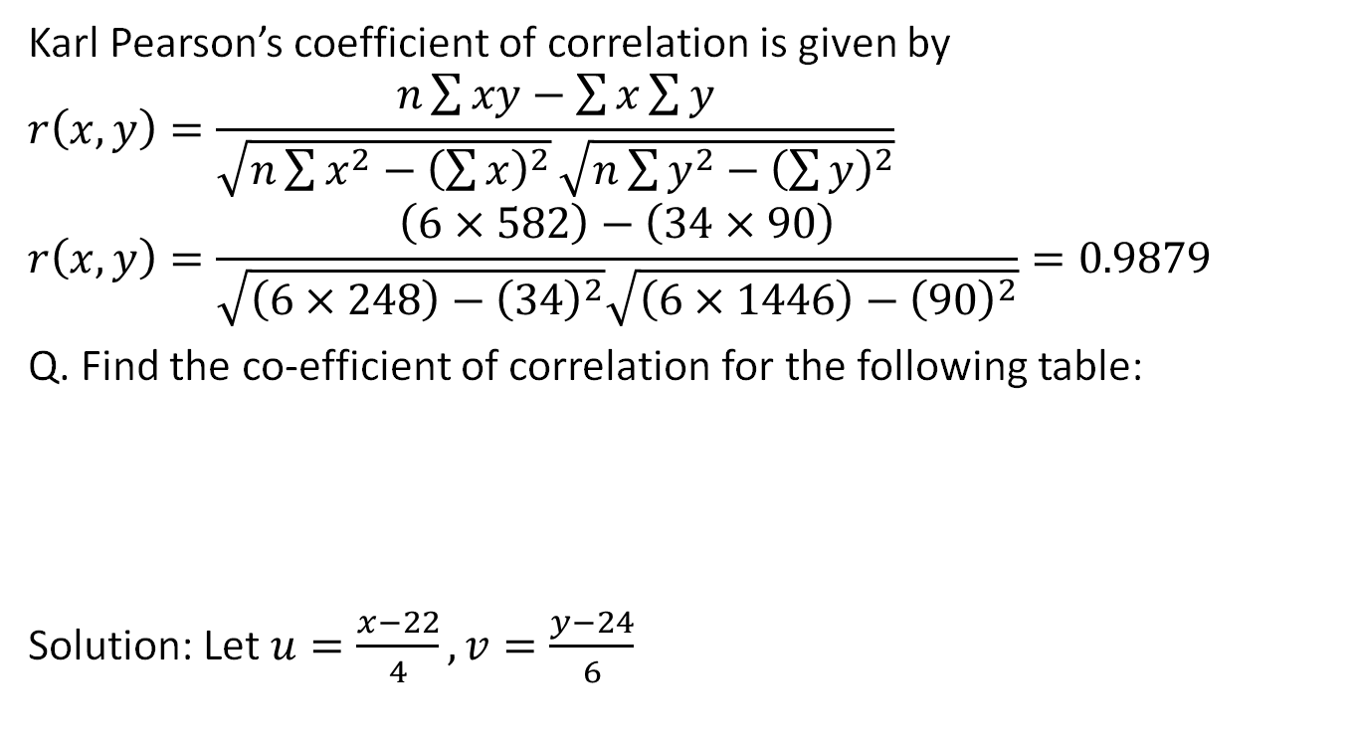
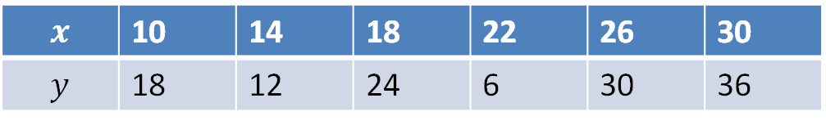
Correlation(CO1)
Karl Pearson’s coefficient of correlation is given by
$$r\left(x,y\right)=\frac{n\sum{xy}−\sum{x}\sum{y}}{\sqrt{n\sum{x^{2}−{\left(\sum{x}\right)}^{2}}}\sqrt{n\sum{y^{2}−{\left(\sum{y}\right)}^{2}}}}$$
$$r\left(x,y\right)=\frac{\left(6×582\right)−\left(34×90\right)}{\sqrt{\left(6×248\right)−{\left(34\right)}^{2}}\sqrt{\left(6×1446\right)−{\left(90\right)}^{2}}}=0.9879$$
Q. Find the co-efficient of correlation for the following table:
Solution: Let $u=\frac{x−22}{4},v=\frac{y−24}{6}$
$$x$$ | 10 | 14 | 18 | 22 | 26 | 30
$$y$$ | 18 | 12 | 24 | 6 | 30 | 36

Slide 36
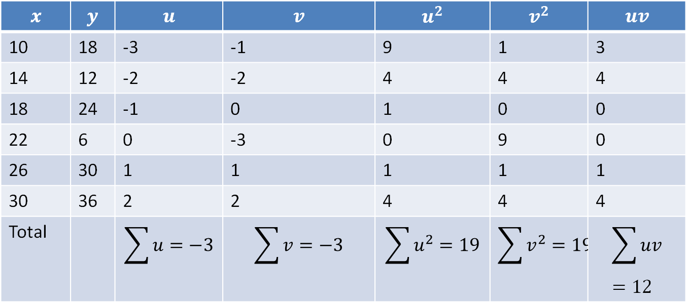
Correlation(CO1)
$$x$$ | $$y$$ | $$u$$ | $$v$$ | $$u^{2}$$ | $$v^{2}$$ | $$uv$$
10 | 18 | -3 | -1 | 9 | 1 | 3
14 | 12 | -2 | -2 | 4 | 4 | 4
18 | 24 | -1 | 0 | 1 | 0 | 0
22 | 6 | 0 | -3 | 0 | 9 | 0
26 | 30 | 1 | 1 | 1 | 1 | 1
30 | 36 | 2 | 2 | 4 | 4 | 4
Total |  | $$\sum{u}=−3$$ | $$\sum{v}=−3$$ | $$\sum{u^{2}=19}$$ | $$\sum{v^{2}=19}$$ | $$\sum{uv}=12$$

Slide 37
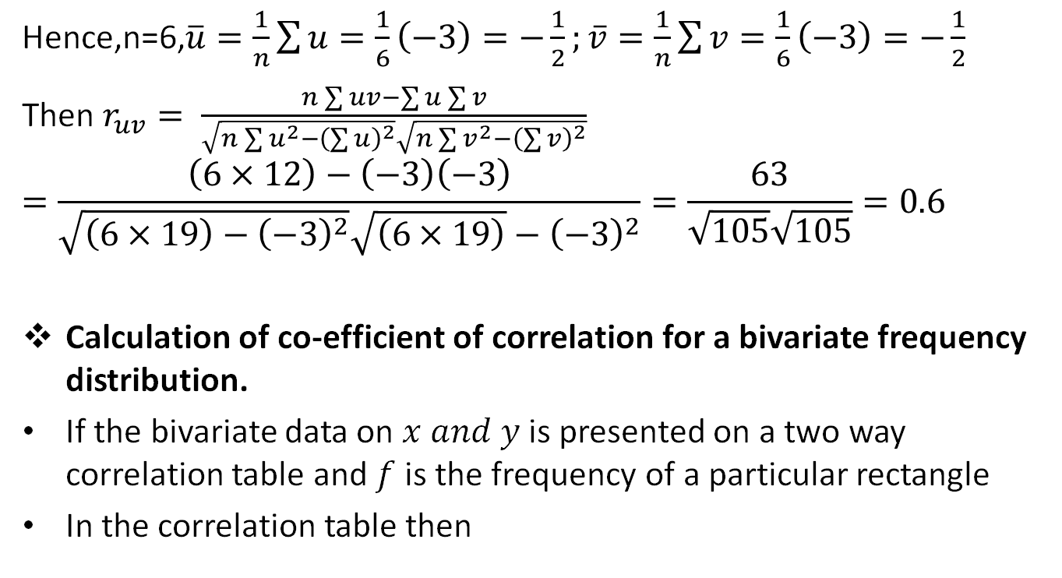
Correlation(CO1)
Hence,n=6,$\overline{u}=\frac{1}{n}\sum{u=\frac{1}{6}\left(−3\right)=−\frac{1}{2};}\overline{v}=\frac{1}{n}\sum{v}=\frac{1}{6}\left(−3\right)=−\frac{1}{2}$
Then $r_{uv}= \frac{n\sum{uv}−\sum{u}\sum{v}}{\sqrt{n\sum{u^{2}−{\left(\sum{u}\right)}^{2}}}\sqrt{n\sum{v^{2}−{\left(\sum{v}\right)}^{2}}}}$
$$=\frac{\left(6×12\right)−\left(−3\right)\left(−3\right)}{\sqrt{\left(6×19\right)−{\left(−3\right)}^{2}}\sqrt{\left(6×19\right)}−{\left(−3\right)}^{2}}=\frac{63}{\sqrt{105}\sqrt{105}}=0.6$$
Calculation of co-efficient of correlation for a bivariate frequency distribution.
If the bivariate data on $x and y$is presented on a two way correlation table and $f$is the frequency of a particular rectangle
In the correlation table then

Slide 38
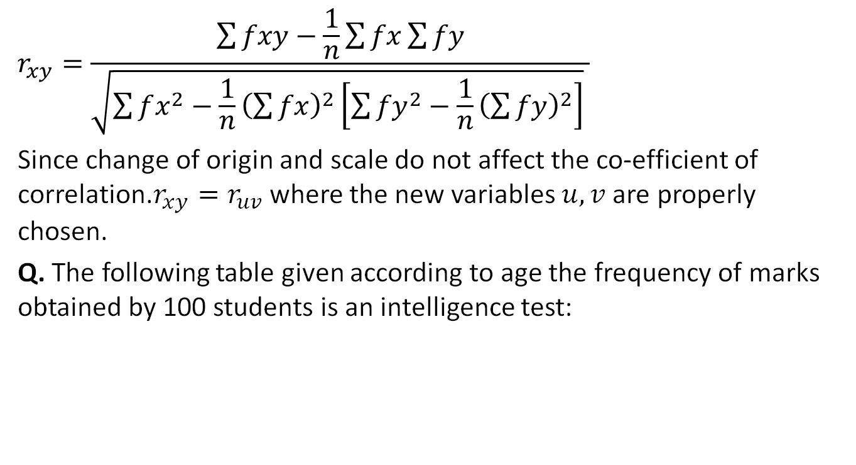
Correlation(CO1)
$$r_{xy}=\frac{\sum{fxy}−\frac{1}{n}\sum{fx}\sum{fy}}{\sqrt{\sum{fx^{2}−\frac{1}{n}{\left(\sum{fx}\right)}^{2}}\left[\sum{{fy}^{2}−\frac{1}{n}{\left(\sum{fy}\right)}^{2}}\right]} }$$
Since change of origin and scale do not affect the co-efficient of correlation.$r_{xy}=r_{uv}$where the new variables $u,v$ are properly chosen.
Q. The following table given according to age the frequency of marks obtained by 100 students is an intelligence test:

Slide 39
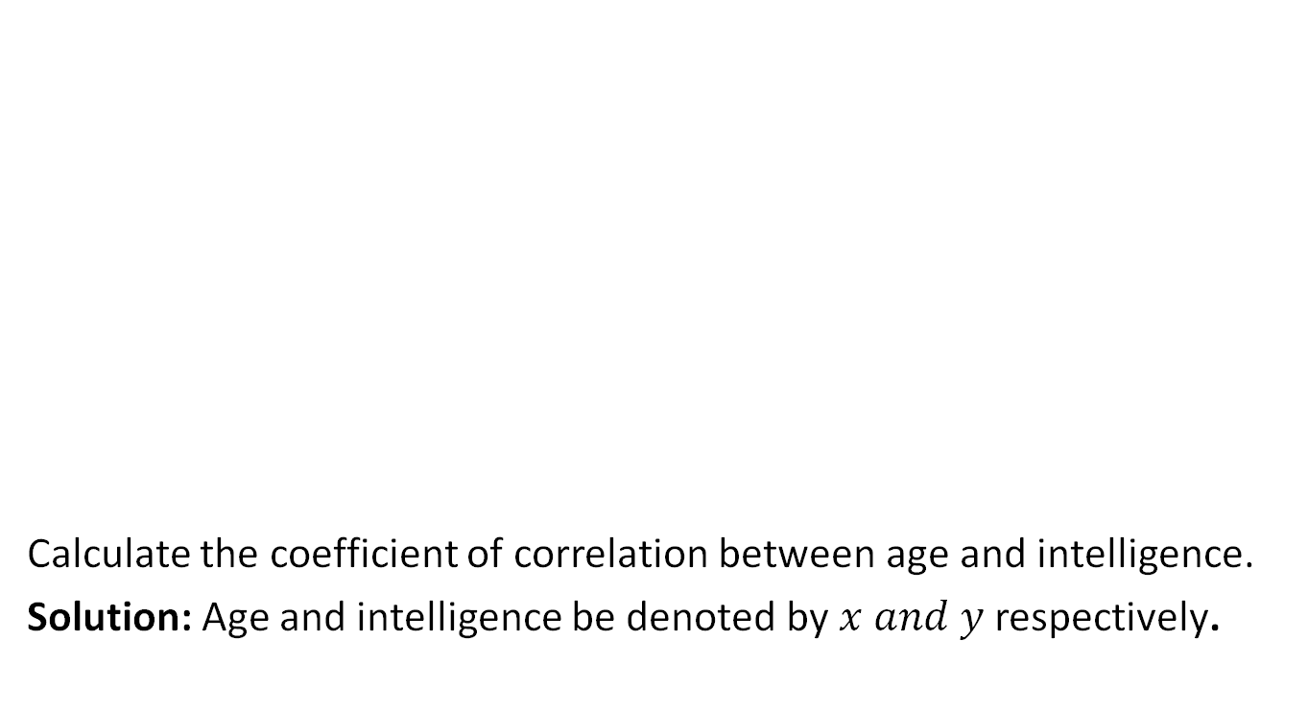
Correlation(CO1)
Calculate the coefficient of correlation between age and intelligence.
Solution: Age and intelligence be denoted by $x and y$ respectively.
Marks | 18 | 19 | 20 | 21 | total
10-20 | 4 | 2 | 2 |  | 8
20-30 | 5 | 4 | 6 | 4 | 19
30-40 | 6 | 8 | 10 | 11 | 35
40-50 | 4 | 4 | 6 | 8 | 22
50-60 |  | 2 | 4 | 4 | 10
60-70 |  | 2 | 3 | 1 | 6
Total | 19 | 22 | 31 | 28 | 100

Slide 40
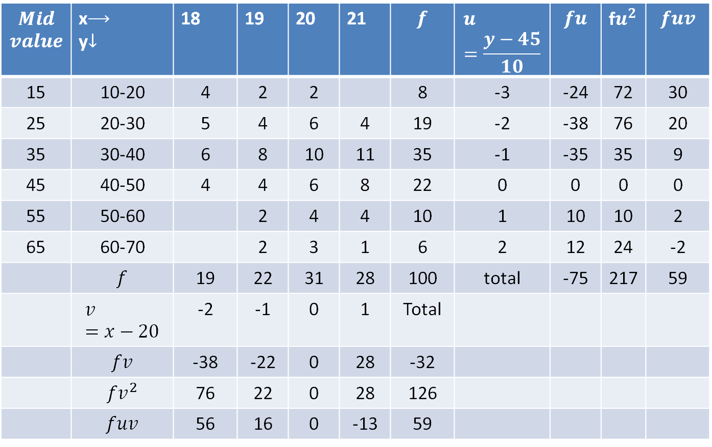
Correlation(CO1)
$$Mid$$ $$value$$ | x$⟶$ y$↓$ | 18 | 19 | 20 | 21 | $$f$$ | $$u=\frac{y−45}{10}$$ | $$fu$$ | f$u^{2}$ | $$fuv$$
15 | 10-20 | 4 | 2 | 2 |  | 8 | -3 | -24 | 72 | 30
25 | 20-30 | 5 | 4 | 6 | 4 | 19 | -2 | -38 | 76 | 20
35 | 30-40 | 6 | 8 | 10 | 11 | 35 | -1 | -35 | 35 | 9
45 | 40-50 | 4 | 4 | 6 | 8 | 22 | 0 | 0 | 0 | 0
55 | 50-60 |  | 2 | 4 | 4 | 10 | 1 | 10 | 10 | 2
65 | 60-70 |  | 2 | 3 | 1 | 6 | 2 | 12 | 24 | -2
 | $$f$$ | 19 | 22 | 31 | 28 | 100 | total | -75 | 217 | 59
 | $$v=x−20$$ | -2 | -1 | 0 | 1 | Total
 | $$fv$$ | -38 | -22 | 0 | 28 | -32
 | $${fv}^{2}$$ | 76 | 22 | 0 | 28 | 126
 | $$fuv$$ | 56 | 16 | 0 | -13 | 59
Notes:
Fuv Calculation_ See Column First: 18 Column: 4 * -3 *-2=+ 24 Similarly , 20 is center value..
19 Column : 2*-3*-1=+ 6
20 Column: 0
21 Column: 0*-3*1= 0 Now Add All= 24+6=30 Similarly Do for All…

Slide 41
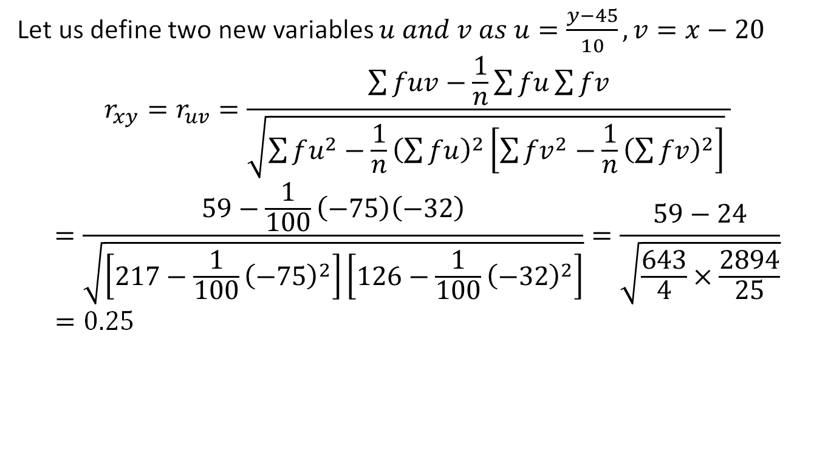
Correlation(CO1)
Let us define two new variables $u and v as u=\frac{y−45}{10},v=x−20$
$$r_{xy}=r_{uv}=\frac{\sum{fuv}−\frac{1}{n}\sum{fu}\sum{fv}}{\sqrt{\sum{fu^{2}−\frac{1}{n}{\left(\sum{fu}\right)}^{2}}\left[\sum{{fv}^{2}−\frac{1}{n}{\left(\sum{fv}\right)}^{2}}\right]} }$$
$$=\frac{59−\frac{1}{100}\left(−75\right)\left(−32\right)}{\sqrt{\left[217−\frac{1}{100}{\left(−75\right)}^{2}\right]\left[126−\frac{1}{100}{\left(−32\right)}^{2}\right]}}=\frac{59−24}{\sqrt{\frac{643}{4}×\frac{2894}{25}}}=0.25$$

Slide 42
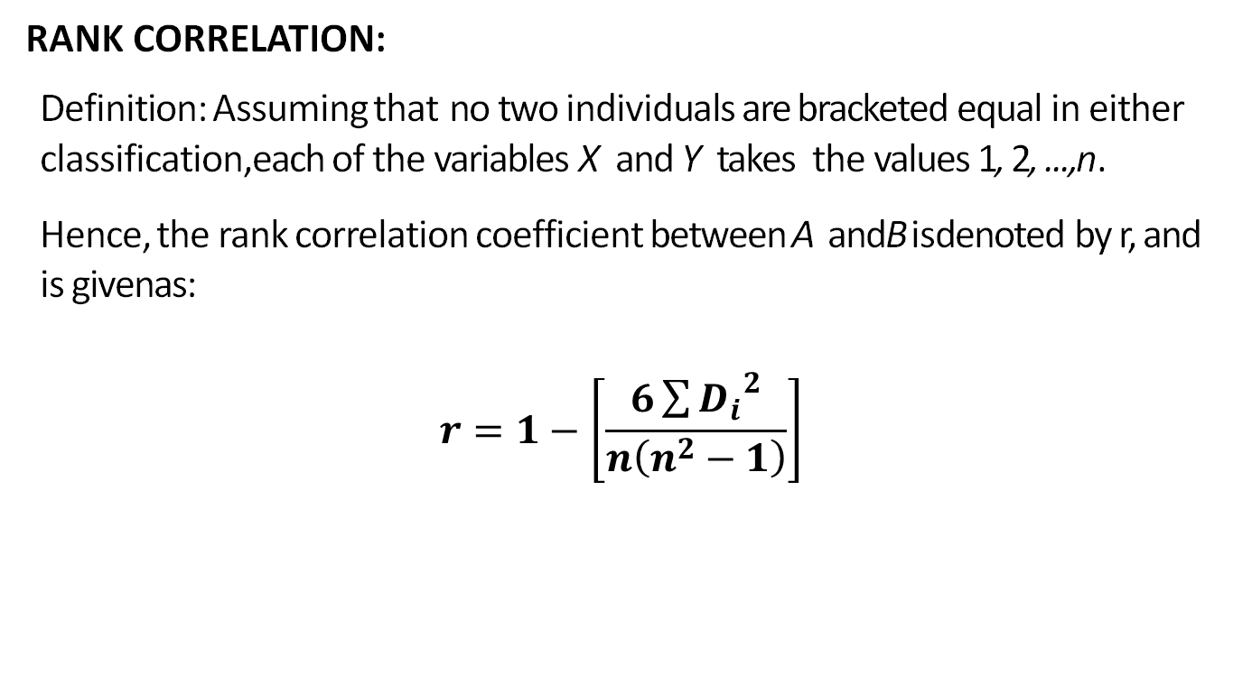
Rank Correlation(CO1)
RANK CORRELATION:
Definition: Assuming that no two individuals are bracketed equal in either classification,each of the variables X and Y takes the values 1, 2, ...,n.
Hence, the rank correlation coefficient between A andBisdenoted by r, and is givenas:
$$r=1−\left[\frac{6\sum{{D_{i}}^{2}}}{n\left(n^{2}−1\right)}\right]$$

Slide 43
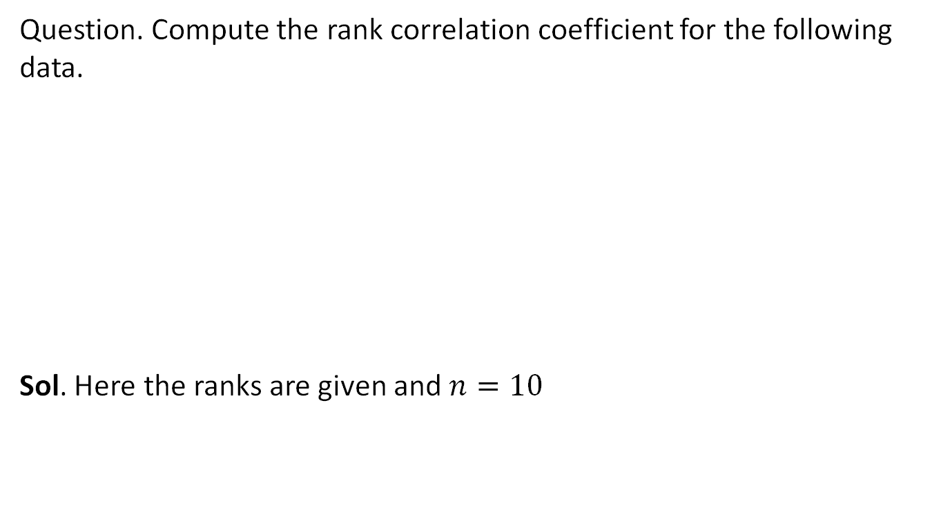
Rank Correlation(CO1)
Question. Compute the rank correlation coefficient for the following data.
Sol. Here the ranks are given and $n=10$
Person | A | B | C | D | E | F | G | H | I | J
Rank in maths | 9 | 10 | 6 | 5 | 7 | 2 | 4 | 8 | 1 | 3
Rank in physics | 1 | 2 | 3 | 4 | 5 | 6 | 7 | 8 | 9 | 10

Slide 44
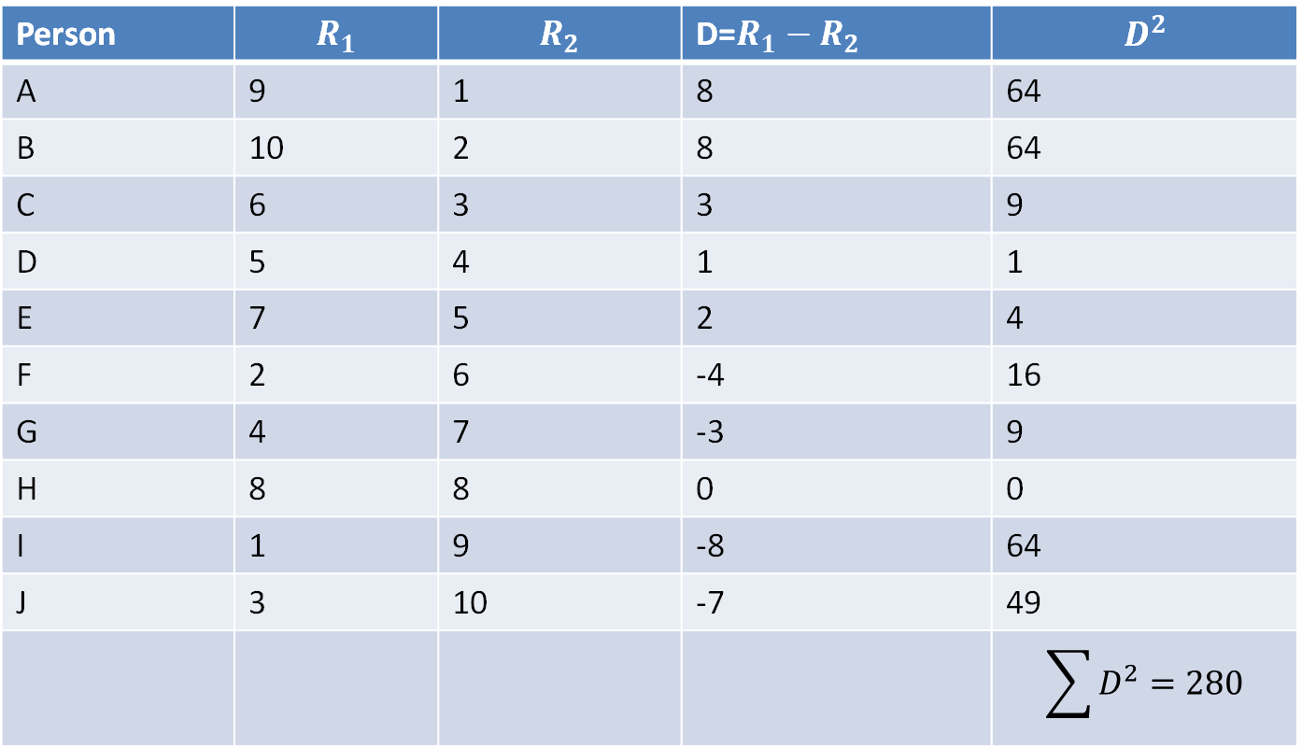
Rank Correlation(CO1)
Person | $$R_{1}$$ | $$R_{2}$$ | D=$R_{1}−R_{2}$ | $$D^{2}$$
A | 9 | 1 | 8 | 64
B | 10 | 2 | 8 | 64
C | 6 | 3 | 3 | 9
D | 5 | 4 | 1 | 1
E | 7 | 5 | 2 | 4
F | 2 | 6 | -4 | 16
G | 4 | 7 | -3 | 9
H | 8 | 8 | 0 | 0
I | 1 | 9 | -8 | 64
J | 3 | 10 | -7 | 49
 |  |  |  | $$\sum{D^{2}=280}$$

Slide 45
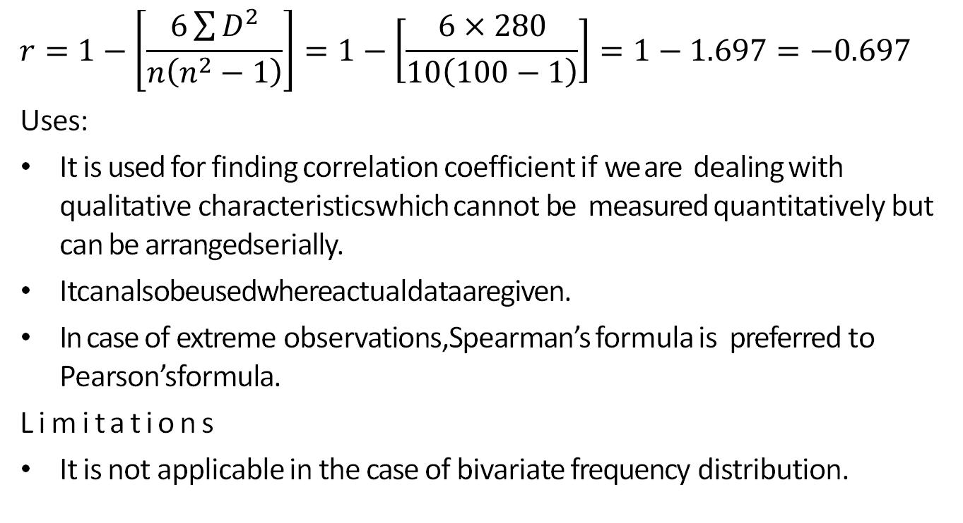
Rank Correlation(CO1)
$$r=1−\left[\frac{6\sum{D^{2}}}{n\left(n^{2}−1\right)}\right]=1−\left[\frac{6×280}{10\left(100−1\right)}\right]=1−1.697=−0.697$$
Uses:
It is used for finding correlation coefficient if we are dealing with qualitative characteristicswhich cannot be measured quantitatively but can be arrangedserially.
Itcanalsobeusedwhereactualdataaregiven.
In case of extreme observations,Spearman’s formula is preferred to Pearson’sformula.
Limitations
It is not applicable in the case of bivariate frequency distribution.

Slide 46
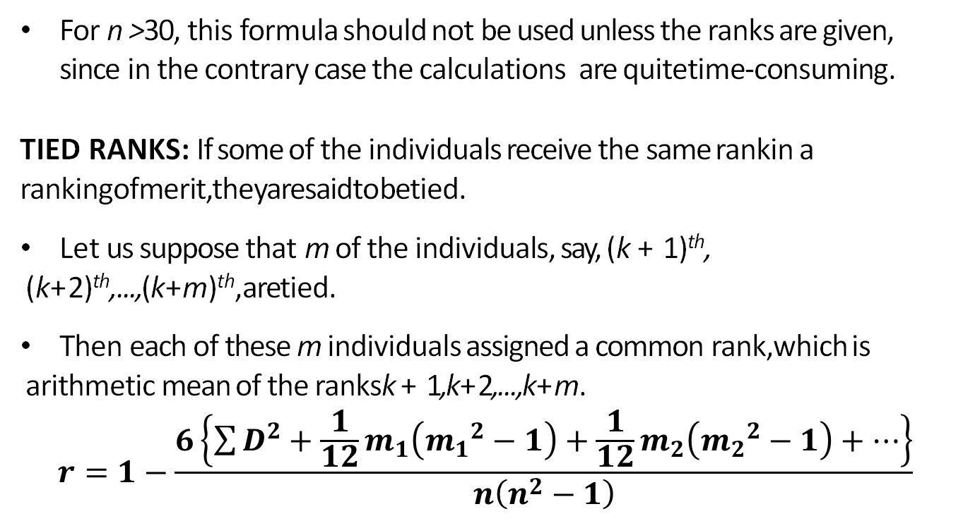
Tied Correlation(CO1)
For n >30, this formula should not be used unless the ranks are given, since in the contrary case the calculations are quitetime-consuming.
TIED RANKS: If some of the individuals receive the same rankin a rankingofmerit,theyaresaidtobetied.
Let us suppose that m of the individuals, say, (k + 1)^{th}, (k+2)^{th},...,(k+m)^{th},aretied.
Then each of these m individuals assigned a common rank,which is arithmetic mean of the ranksk + 1,k+2,...,k+m.
$$r=1−\frac{6\left\{\sum{D^{2}+\frac{1}{12}m_{1}\left({m_{1}}^{2}−1\right)+\frac{1}{12}m_{2}\left({m_{2}}^{2}−1\right)+…}\right\}}{n\left(n^{2}−1\right)}$$

Slide 47
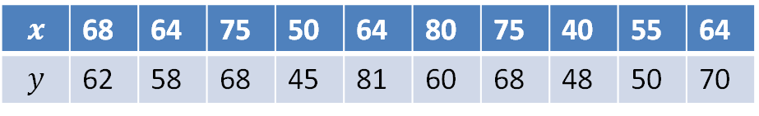
Tied Correlation(CO1)
Question: Obtain the rank correlation co-efficient for the following data:
Solution: Here marks are given so write down the ranks
$$x$$ | 68 | 64 | 75 | 50 | 64 | 80 | 75 | 40 | 55 | 64
$$y$$ | 62 | 58 | 68 | 45 | 81 | 60 | 68 | 48 | 50 | 70

Slide 48
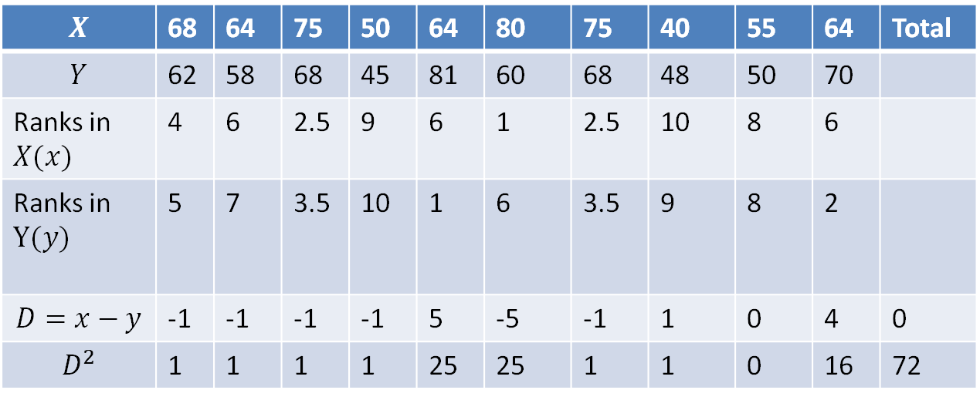
Tied Correlation(CO1)
75
75 2 times
64 3 times
68 2 times
$$X$$ | 68 | 64 | 75 | 50 | 64 | 80 | 75 | 40 | 55 | 64 | Total
$$Y$$ | 62 | 58 | 68 | 45 | 81 | 60 | 68 | 48 | 50 | 70
Ranks in $X(x)$ | 4 | 6 | 2.5 | 9 | 6 | 1 | 2.5 | 10 | 8 | 6
Ranks in $Y(y)$ | 5 | 7 | 3.5 | 10 | 1 | 6 | 3.5 | 9 | 8 | 2
$$D=x−y$$ | -1 | -1 | -1 | -1 | 5 | -5 | -1 | 1 | 0 | 4 | 0
$$D^{2}$$ | 1 | 1 | 1 | 1 | 25 | 25 | 1 | 1 | 0 | 16 | 72

Slide 49
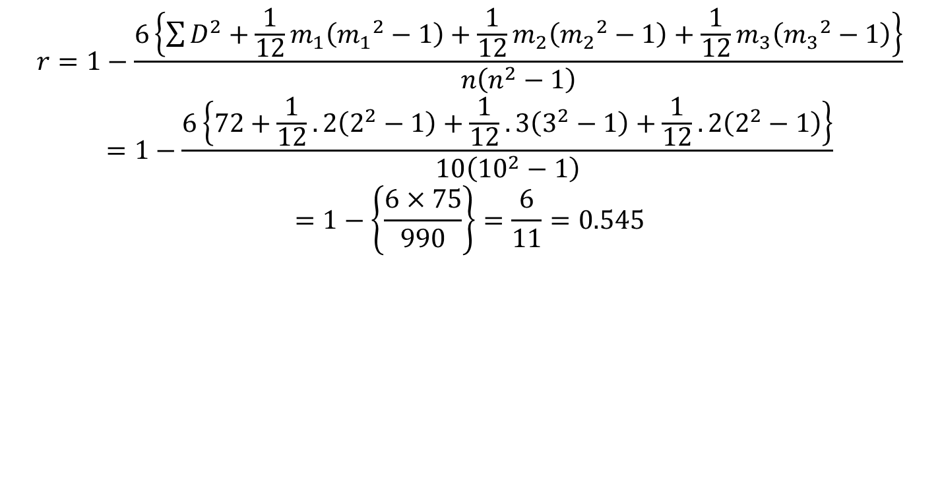
Tied Correlation(CO1)
$$r=1−\frac{6\left\{\sum{D^{2}+\frac{1}{12}m_{1}\left({m_{1}}^{2}−1\right)+\frac{1}{12}m_{2}\left({m_{2}}^{2}−1\right)+\frac{1}{12}m_{3}\left({m_{3}}^{2}−1\right)}\right\}}{n\left(n^{2}−1\right)}$$
$$=1−\frac{6\left\{72+\frac{1}{12}.2\left(2^{2}−1\right)+\frac{1}{12}.3\left(3^{2}−1\right)+\frac{1}{12}.2\left(2^{2}−1\right)\right\}}{10\left({10}^{2}−1\right)}$$
$$=1−\left\{\frac{6×75}{990}\right\}=\frac{6}{11}=0.545$$

Slide 50
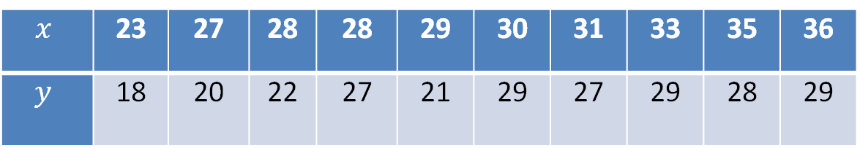
Daily Quiz(CO1)
Q1. Find the rank correlation coefficient for the following data:
$$x$$ | 23 | 27 | 28 | 28 | 29 | 30 | 31 | 33 | 35 | 36
$$y$$ | 18 | 20 | 22 | 27 | 21 | 29 | 27 | 29 | 28 | 29

Slide 51
Recap(CO1)
Correlation
Karl Pearson coefficient of correlation
Rank Correlation
Tied Rank

Slide 52
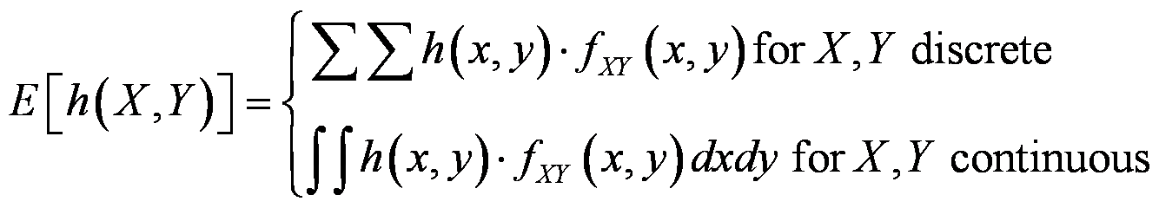
Covariance
Regression basics: Relationship between attributes using Covariance and Correlation
Covariance is a measure of the relationship between two random variables.
First, we need to describe the expected value of a function of two random variables. Let h(X, Y) denote the function of interest.

Slide 53
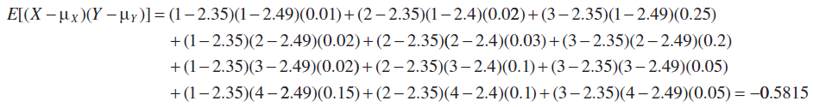
Example 5-19: Expected Value of a Function of Two Random Variables
Regression basics: Relationship between attributes using Covariance and Correlation
For the joint probability distribution of the two random variables in Example 5-1, calculate E [(X-μ_{X})(Y-μ_{Y})].
The result is obtained by multiplying x - μ_{X} times y - μ_{Y}, times f_{xy}(X,Y) for each point in the range of (X,Y). First, μ_{X} and μ_{y} were determined previously from the marginal distributions for X and Y:
μ_{X} = 2.35 and μ_{y} = 2.49
Therefore,

Slide 54
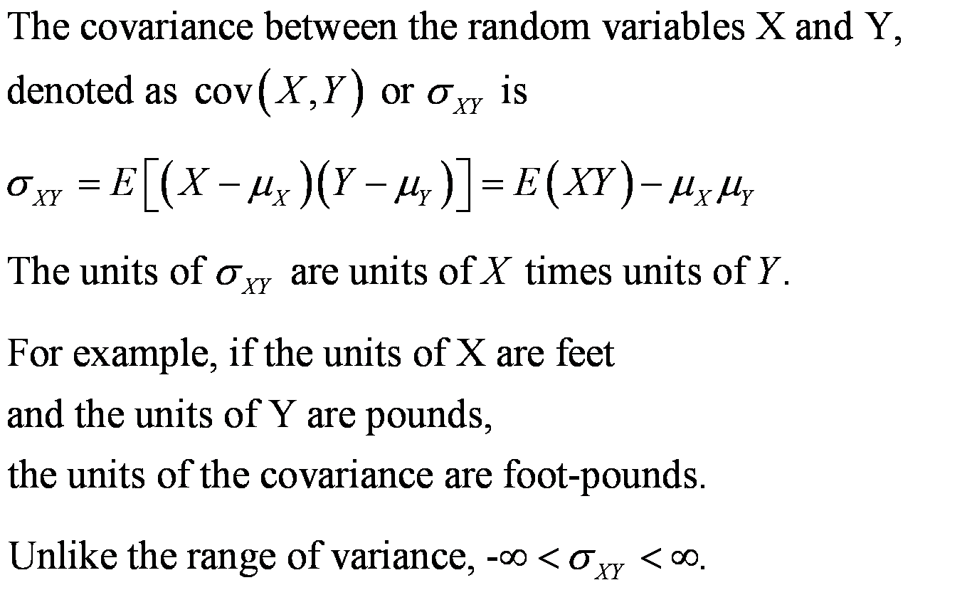
Covariance Defined
Regression basics: Relationship between attributes using Covariance and Correlation

Slide 55
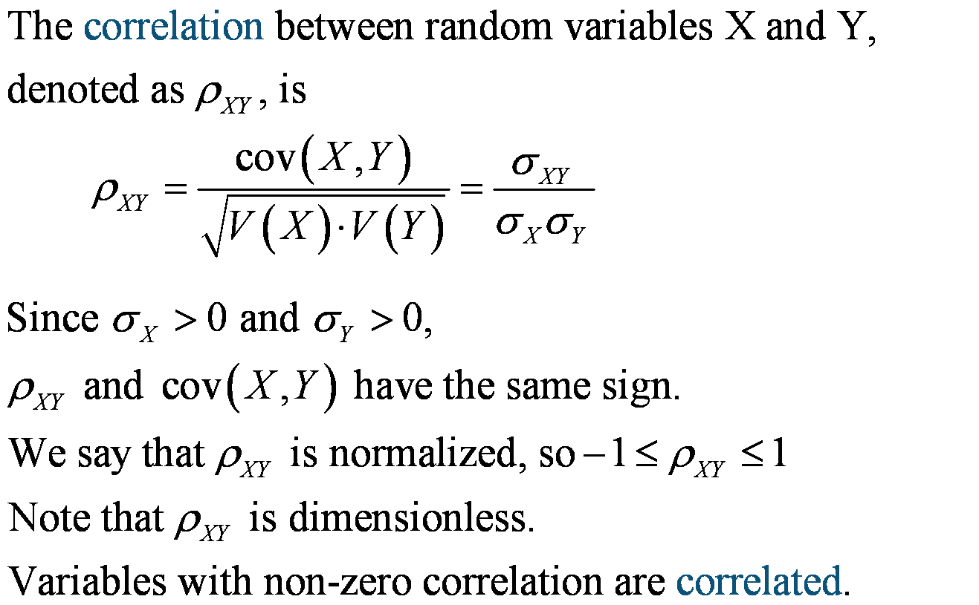
Correlation (ρ = rho)
Regression basics: Relationship between attributes using Covariance and Correlation

Slide 56
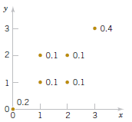
Example 5-21: Covariance & Correlation
Regression basics: Relationship between attributes using Covariance and Correlation
Determine the covariance
and correlation to the figure
below.
Figure 5-13 Discrete joint distribution, f(x, y).

Slide 57
Independence Implies ρ = 0
Regression basics: Relationship between attributes using Covariance and Correlation
If X and Y are independent random variables,
σ_{XY} = ρ_{XY} = 0
ρ_{XY} = 0 is necessary, but not a sufficient condition for independence.

Slide 58
Topic objectives (CO1)
Regression
Explanation of the variation in the dependent variable, based on the variation in independent variables and Predict the values of the dependent variable.

Slide 59
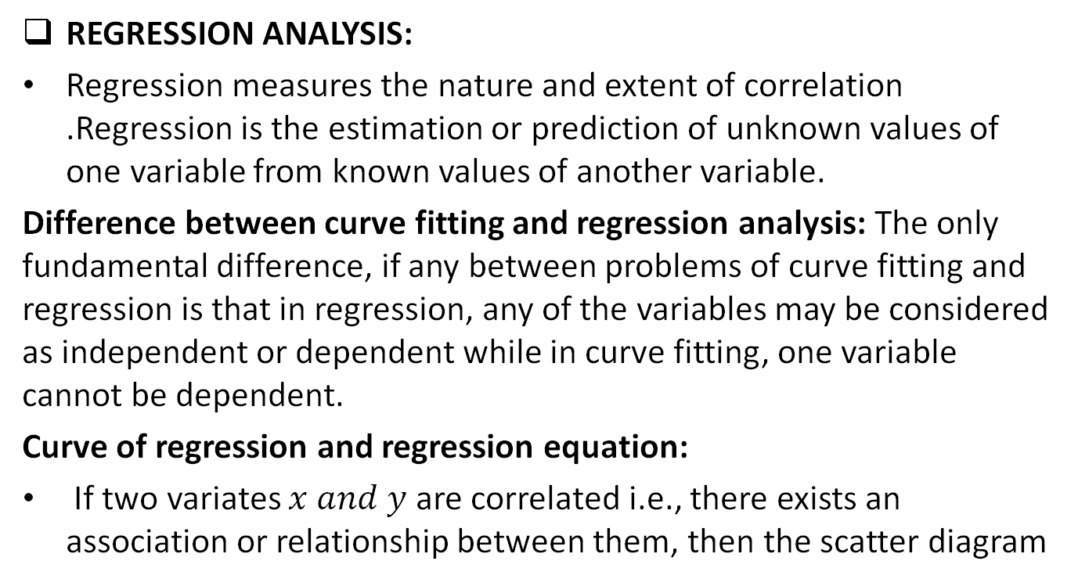
Regression Analysis(CO1)
REGRESSION ANALYSIS:
Regression measures the nature and extent of correlation .Regression is the estimation or prediction of unknown values of one variable from known values of another variable.
Difference between curve fitting and regression analysis: The only fundamental difference, if any between problems of curve fitting and regression is that in regression, any of the variables may be considered as independent or dependent while in curve fitting, one variable cannot be dependent.
Curve of regression and regression equation:
If two variates $x and y$ are correlated i.e., there exists an association or relationship between them, then the scatter diagram

Slide 60
Regression Analysis(CO1)
will be more or less concentrated round a curve. This curve is called the curve of regression and the relationship is said to be expressed by means of curvilinear regression.
The mathematical equation of the regression curve is called regression equation.
Some following types of regression will discuss here:
Linear Regression
Non- linear Regression
Multiple linear Regression

Slide 61
Linear Regression(CO1)
LINEAR REGRESSION:
When the point of the scatter diagram concentrated round a straight line, the regression is called linear and this straight line is known as the line of regression.
Regression will be called non-linear if there exists a relationship other than a straight line between the variables under consideration.

Slide 62
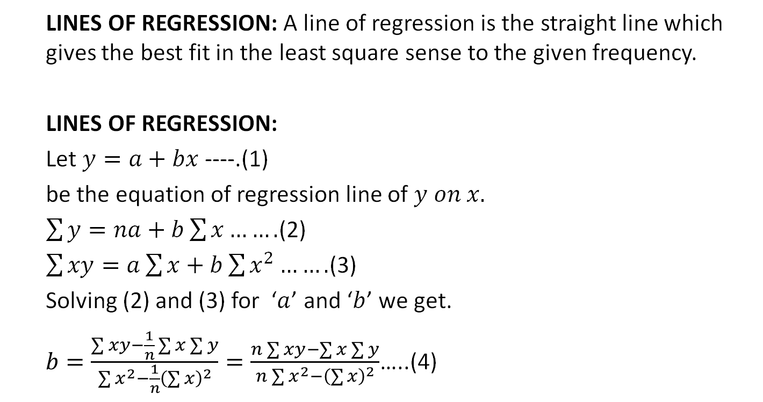
Linear Regression(CO1)
LINES OF REGRESSION: A line of regression is the straight line which gives the best fit in the least square sense to the given frequency.
LINES OF REGRESSION:
Let $y=a+bx$ ----.(1)
be the equation of regression line of $y on x.$
$\sum{y=na+b\sum{x…….}}$(2)
$\sum{xy=a\sum{x}+b\sum{x^{2}…….}}$(3)
Solving (2) and (3) for ‘$a$’ and ‘$b$’ we get.
$b=\frac{\sum{xy}−\frac{1}{n}\sum{x}\sum{y}}{\sum{x^{2}−\frac{1}{n}{\left(\sum{x}\right)}^{2}}}=\frac{n\sum{xy}−\sum{x}\sum{y}}{n\sum{x^{2}−{\left(\sum{x}\right)}^{2}}}$…..(4)

Slide 63
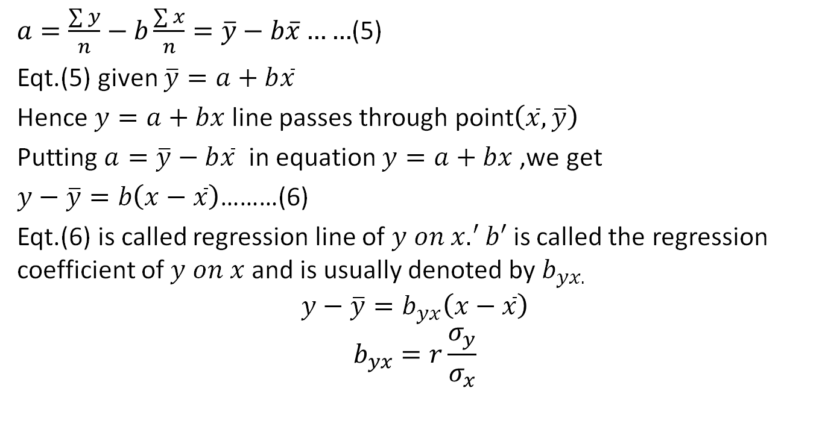
Linear Regression(CO1)
$a=\frac{\sum{y}}{n}−b\frac{\sum{x}}{n}=\overline{y}−b\overline{x}……$(5)
Eqt.(5) given $\overline{y}=a+b\overline{x}$
Hence $y=a+bx$line passes through point$\left(\overline{x},\overline{y}\right)$
Putting $a=\overline{y}−b\overline{x}$ in equation $y=a+bx$,we get
$y−\overline{y}=b\left(x−\overline{x}\right)$………(6)
Eqt.(6) is called regression line of $y on x.^{′}b′$ is called the regression coefficient of $y on x$ and is usually denoted by $b_{yx.}$
$$y−\overline{y}=b_{yx}\left(x−\overline{x}\right)$$
$$b_{yx}=r\frac{σ_{y}}{σ_{x}}$$

Slide 64
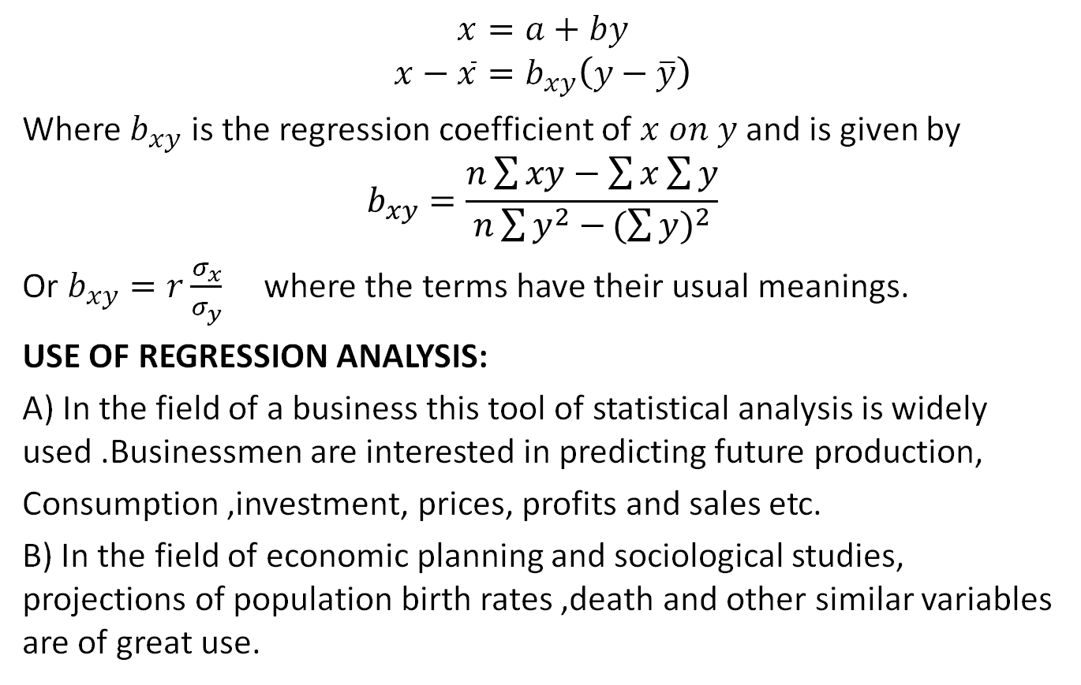
Linear Regression(CO1)
$$x=a+by$$
$$x−\overline{x}=b_{xy}\left(y−\overline{y}\right)$$
Where $b_{xy}$ is the regression coefficient of $x on y$and is given by
$$b_{xy}=\frac{n\sum{xy}−\sum{x}\sum{y}}{n\sum{y^{2}−}{(\sum{y})}^{2}}$$
Or $b_{xy}=r\frac{σ_{x}}{σ_{y}}$ where the terms have their usual meanings.
USE OF REGRESSION ANALYSIS:
A) In the field of a business this tool of statistical analysis is widely used .Businessmen are interested in predicting future production,
Consumption ,investment, prices, profits and sales etc.
B) In the field of economic planning and sociological studies, projections of population birth rates ,death and other similar variables are of great use.

Slide 65
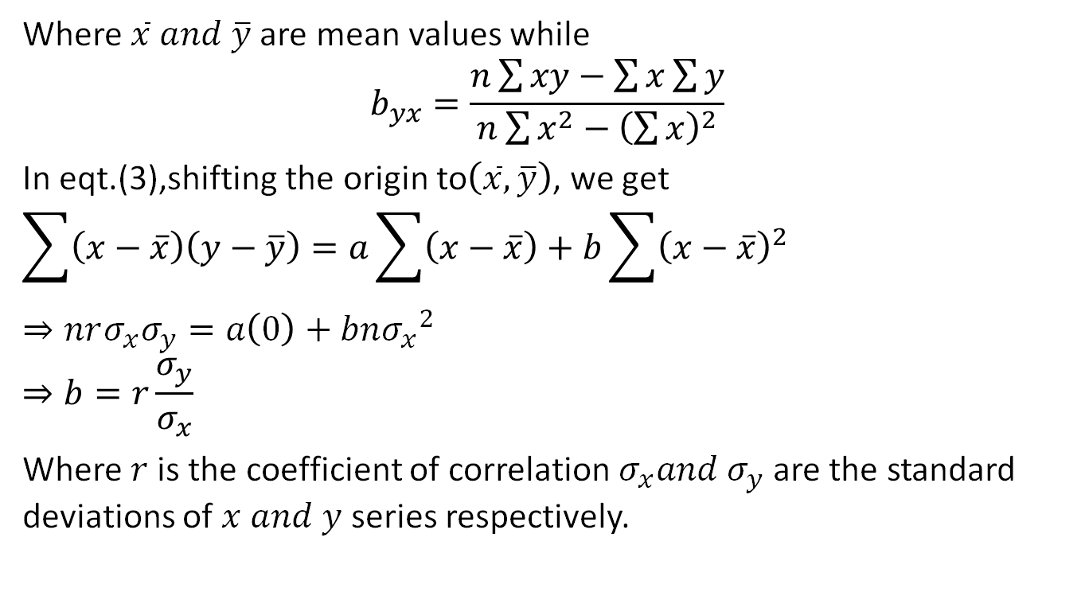
Linear Regression(CO1)
Where $\overline{x} and \overline{y}$are mean values while
$$b_{yx}=\frac{n\sum{xy}−\sum{x}\sum{y}}{n\sum{x^{2}−{\left(\sum{x}\right)}^{2}}}$$
In eqt.(3),shifting the origin to$\left(\overline{x},\overline{y}\right)$, we get
$$\sum{\left(x−\overline{x}\right)\left(y−\overline{y}\right)=a\sum{\left(x−\overline{x}\right)+b\sum{{\left(x−\overline{x}\right)}^{2}}}}$$
$$⇒nrσ_{x}σ_{y}=a\left(0\right)+bn{σ_{x}}^{2}$$
$$⇒b=r\frac{σ_{y}}{σ_{x}}$$
Where $r$is the coefficient of correlation $σ_{x}{and σ}_{y}$ are the standard deviations of $x and y$ series respectively.

Slide 66
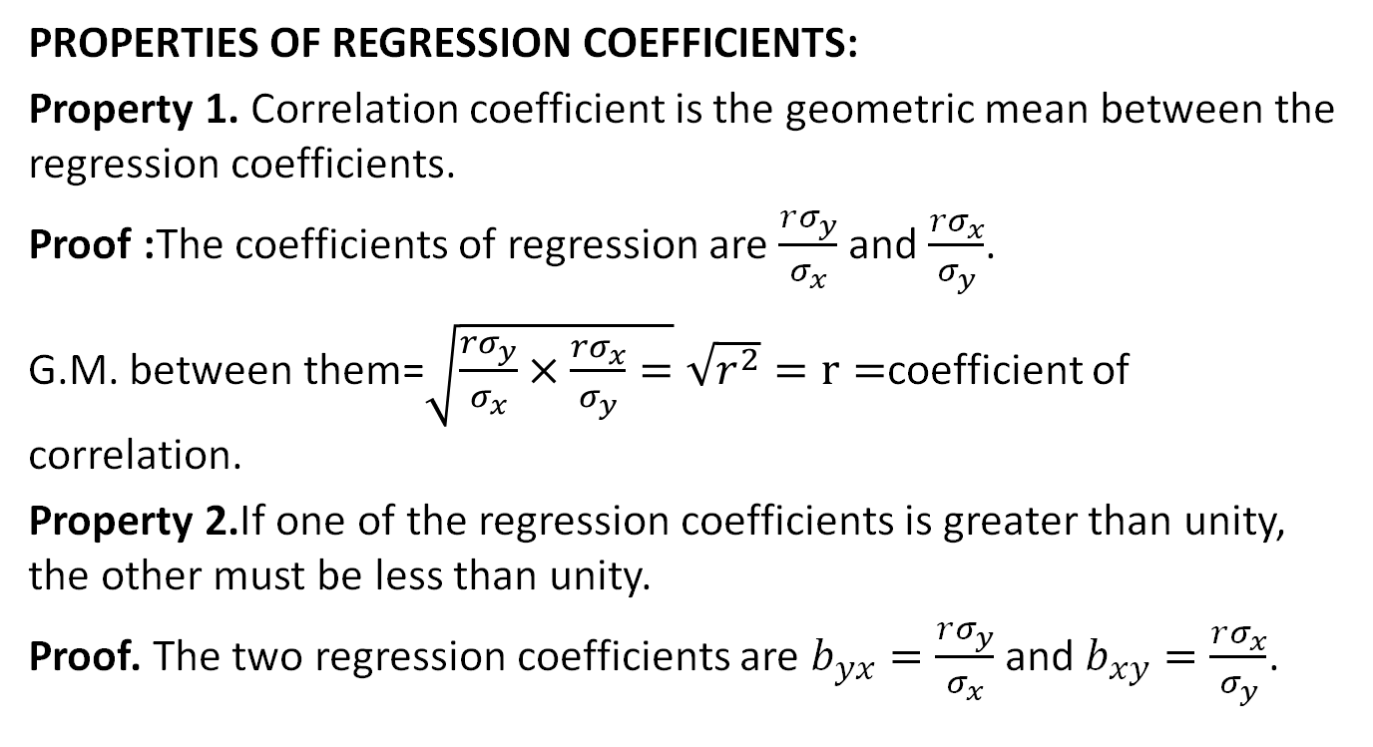
Regression Analysis Properties(CO1)
PROPERTIES OF REGRESSION COEFFICIENTS:
Property 1. Correlation coefficient is the geometric mean between the regression coefficients.
Proof :The coefficients of regression are $\frac{rσ_{y}}{σ_{x}}$ and $\frac{{rσ}_{x}}{σ_{y}}$.
G.M. between them=$\sqrt{\frac{rσ_{y}}{σ_{x}}×\frac{{rσ}_{x}}{σ_{y}}=}\sqrt{r^{2}}=r=$coefficient of correlation.
Property 2.If one of the regression coefficients is greater than unity, the other must be less than unity.
Proof. The two regression coefficients are $b_{yx}=\frac{rσ_{y}}{σ_{x}}$ and $b_{xy}=\frac{rσ_{x}}{σ_{y}}$.

Slide 67
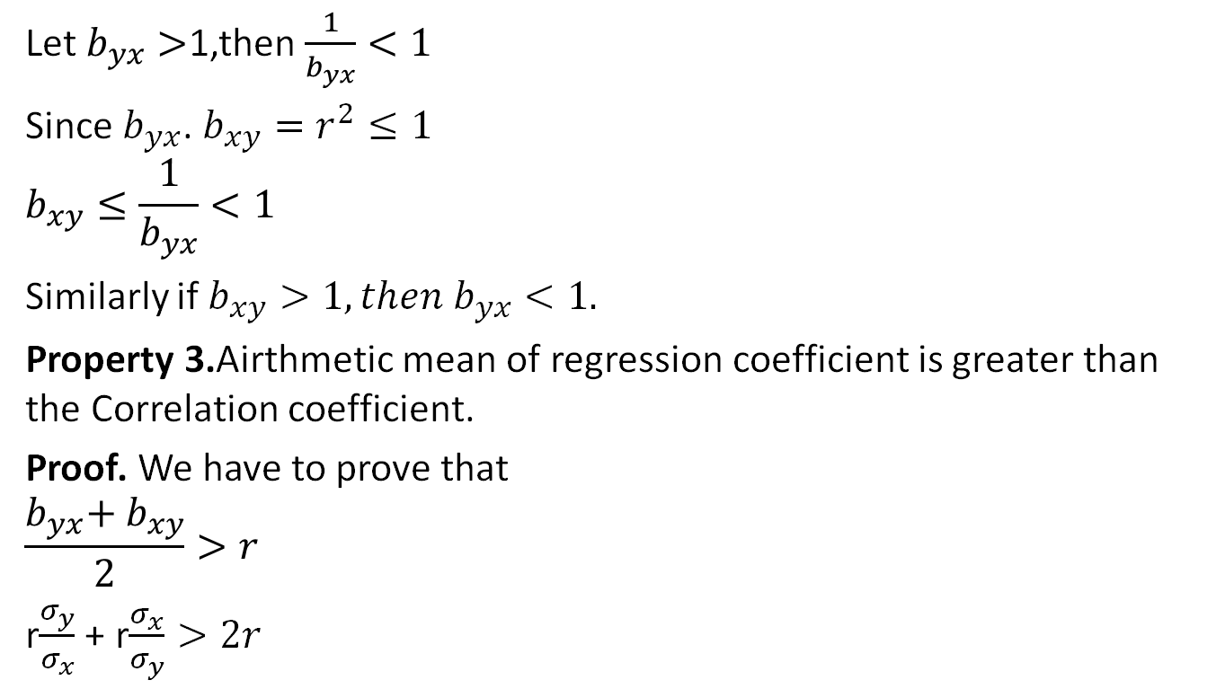
Regression Analysis Properties(CO1)
Let $b_{yx}>$1,then $\frac{1}{b_{yx}}<1$
Since $b_{yx}$. $b_{xy}=r^{2}≤1$
$$b_{xy}≤\frac{1}{b_{yx}}<1$$
Similarly if $b_{xy}>1, then b_{yx}<1.$
Property 3.Airthmetic mean of regression coefficient is greater than the Correlation coefficient.
Proof. We have to prove that
$$\frac{b_{yx}\text{+} b_{xy}}{2}>r$$
r$\frac{σ_{y}}{σ_{x}}$ + r$\frac{σ_{x}}{σ_{y}}>2r$

Slide 68
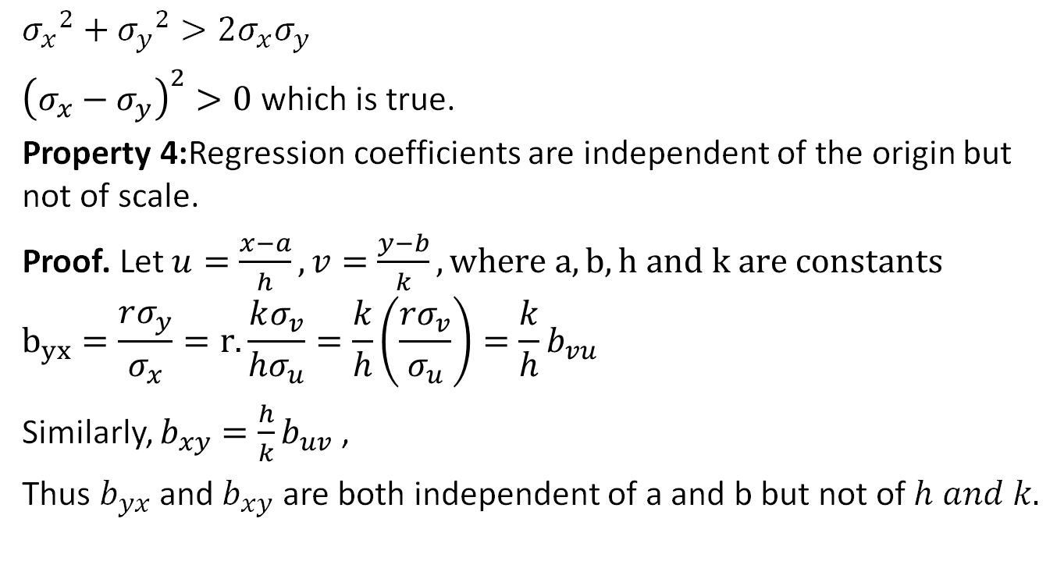
Regression Analysis Properties(CO1)
$${σ_{x}}^{2}+{σ_{y}}^{2}>2σ_{x}σ_{y}$$
${\left(σ_{x}−σ_{y}\right)}^{2}>0$ which is true.
Property 4:Regression coefficients are independent of the origin but not of scale.
Proof. Let $u=\frac{x−a}{h},v=\frac{y−b}{k},where a,b,h and k are constants$
$$b_{yx}=\frac{rσ_{y}}{σ_{x}}=r.\frac{kσ_{v}}{hσ_{u}}=\frac{k}{h}\left(\frac{{rσ}_{v}}{σ_{u}}\right)=\frac{k}{h}b_{vu}$$
Similarly, $b_{xy}=\frac{h}{k}b_{uv}$ ,
Thus $b_{yx}$ and $b_{xy}$ are both independent of a and b but not of $h and k.$

Slide 69
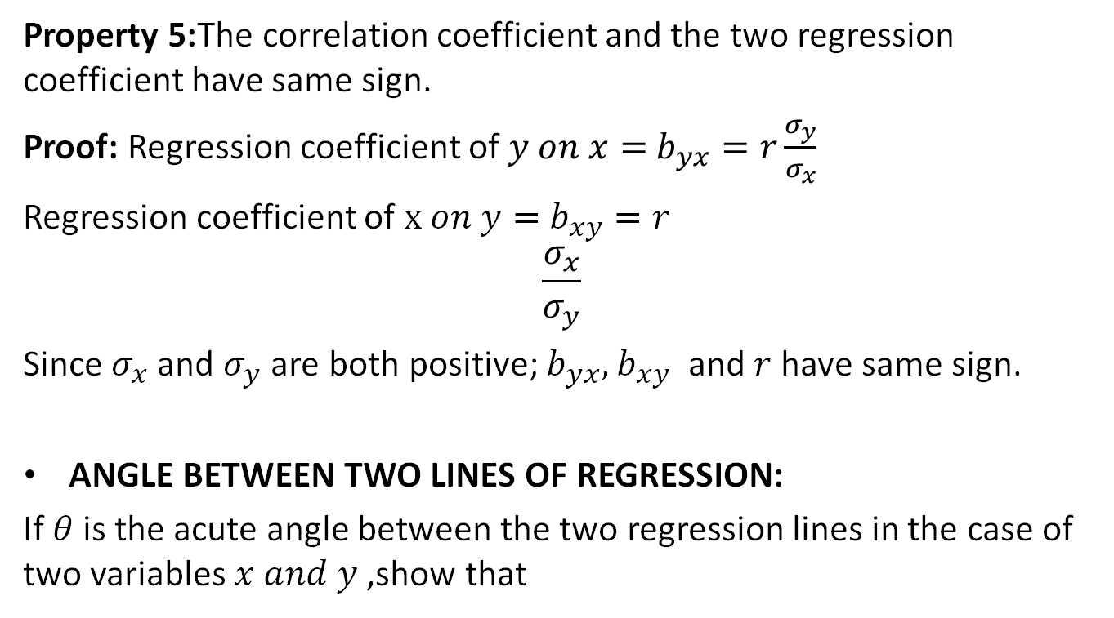
Regression Analysis Properties(CO1)
Property 5:The correlation coefficient and the two regression coefficient have same sign.
Proof: Regression coefficient of $y on x=$ $b_{yx}=r\frac{σ_{y}}{σ_{x}}$
Regression coefficient of $x on y=$ $b_{xy}=r$
$$\frac{σ_{x}}{σ_{y}}$$
Since $σ_{x}$ and $σ_{y}$ are both positive; $b_{yx},$ $b_{xy}$ and $r$ have same sign.
ANGLE BETWEEN TWO LINES OF REGRESSION:
If $θ$is the acute angle between the two regression lines in the case of two variables $x and y$ ,show that

Slide 70
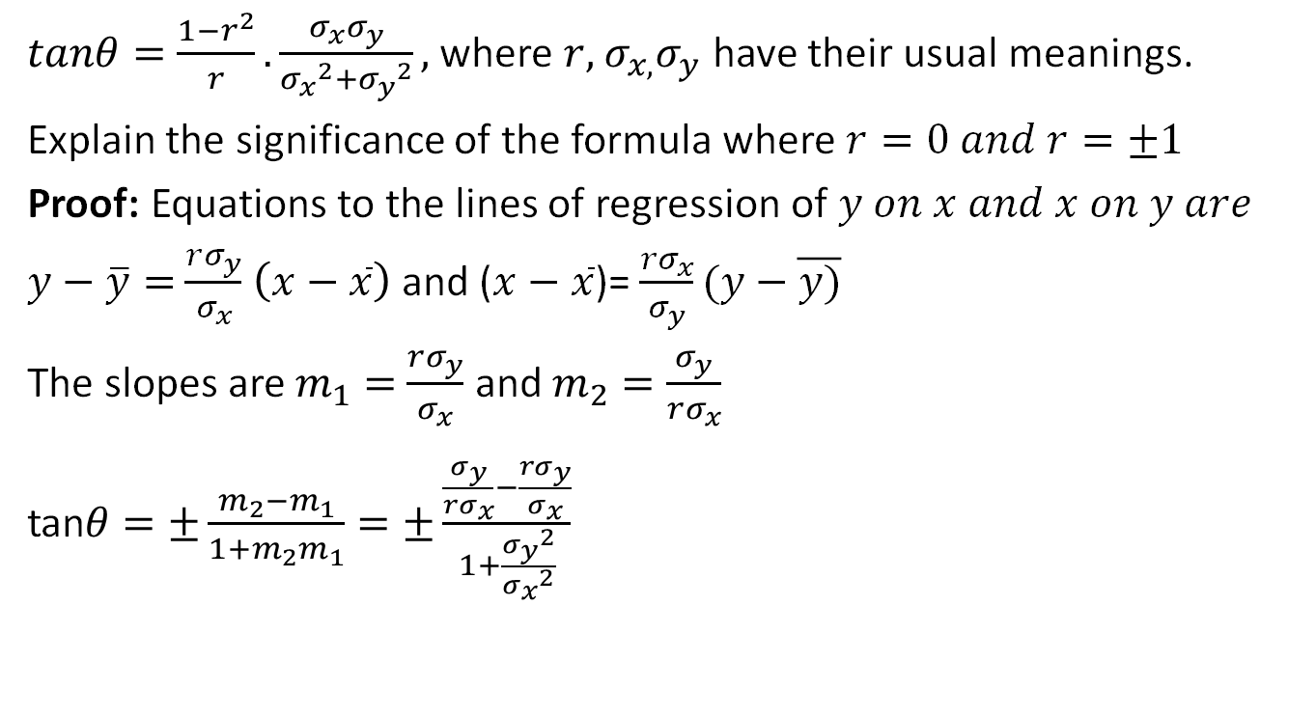
Regression Analysis Properties(CO1)
$tanθ=\frac{1−r^{2}}{r}.\frac{σ_{x}σ_{y}}{{σ_{x}}^{2}+{σ_{y}}^{2}},$ where $r,$ $σ_{x,}σ_{y}$ have their usual meanings.
Explain the significance of the formula where $r=0 and r=±1$
Proof: Equations to the lines of regression of $y on x and x on y are$
$y−\overline{y}=$ $\frac{rσ_{y}}{σ_{x}}$ $\left(x−\overline{x}\right)$ and ($x−\overline{x}$)= $\frac{{rσ}_{x}}{σ_{y}}(y−\overline{y)}$
The slopes are $m_{1}=$ $\frac{rσ_{y}}{σ_{x}}$ and $m_{2}=\frac{σ_{y}}{rσ_{x}}$
tan$θ=±\frac{m_{2}−m_{1}}{1+m_{2}m_{1}}=±\frac{\frac{σ_{y}}{rσ_{x}}−\frac{rσ_{y}}{σ_{x}}}{1+\frac{{σ_{y}}^{2}}{{σ_{x}}^{2}}}$

Slide 71
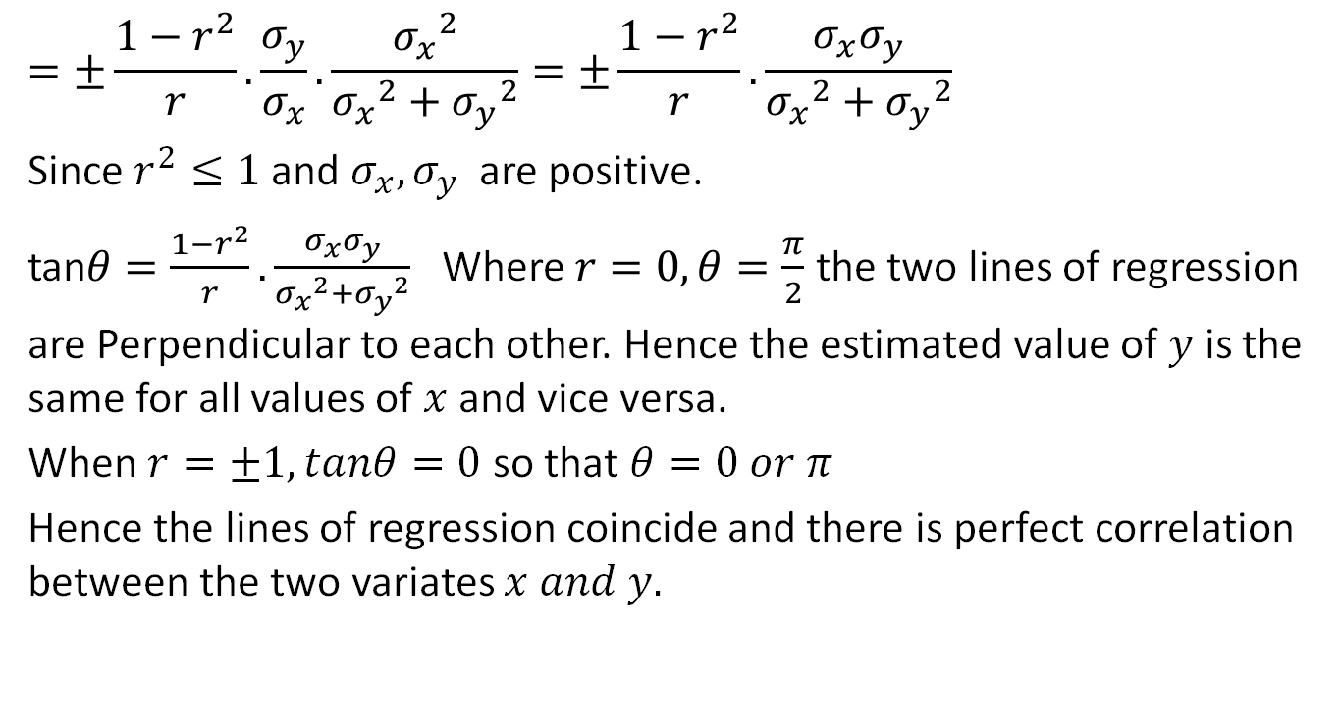
Regression Analysis Properties(CO1)
$$=±\frac{1−r^{2}}{r}.\frac{σ_{y}}{σ_{x}}.\frac{{σ_{x}}^{2}}{{σ_{x}}^{2}+{σ_{y}}^{2}}=±\frac{1−r^{2}}{r}.\frac{σ_{x}σ_{y}}{{σ_{x}}^{2}+{σ_{y}}^{2}}$$
Since $r^{2}≤1$ and $σ_{x}{,σ}_{y}$are positive.
tan$θ=\frac{1−r^{2}}{r}.\frac{σ_{x}σ_{y}}{{σ_{x}}^{2}+{σ_{y}}^{2}}$ Where $r=0,θ=\frac{π}{2}$ the two lines of regression are Perpendicular to each other. Hence the estimated value of $y$ is the same for all values of $x$and vice versa.
When $r=±1,tanθ=0$ so that $θ=0 or π$
Hence the lines of regression coincide and there is perfect correlation between the two variates $x and y.$

Slide 72
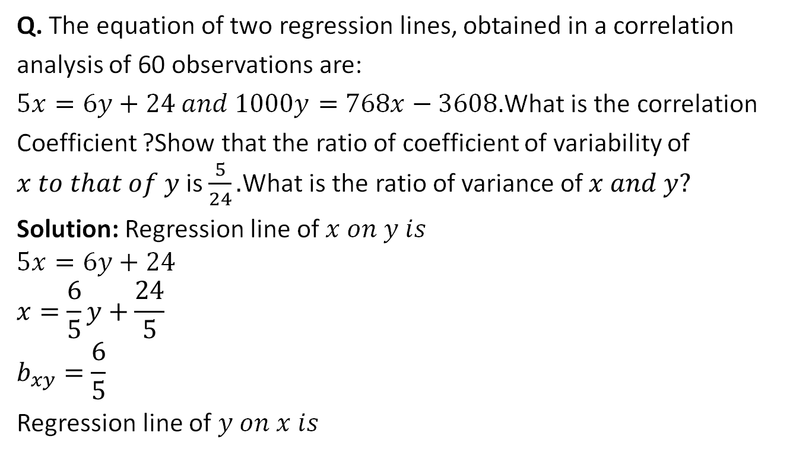
Linear Regression(CO1)
Q. The equation of two regression lines, obtained in a correlation
analysis of 60 observations are:
$5x=6y+24 and 1000y=768x−3608.$What is the correlation
Coefficient ?Show that the ratio of coefficient of variability of $x to that of y$ is $\frac{5}{24}.$What is the ratio of variance of $x and y?$
Solution: Regression line of $x on y is$
$$5x=6y+24$$
$$x=\frac{6}{5}y+\frac{24}{5}$$
$$b_{xy}=\frac{6}{5}$$
Regression line of $y on x is$

Slide 73
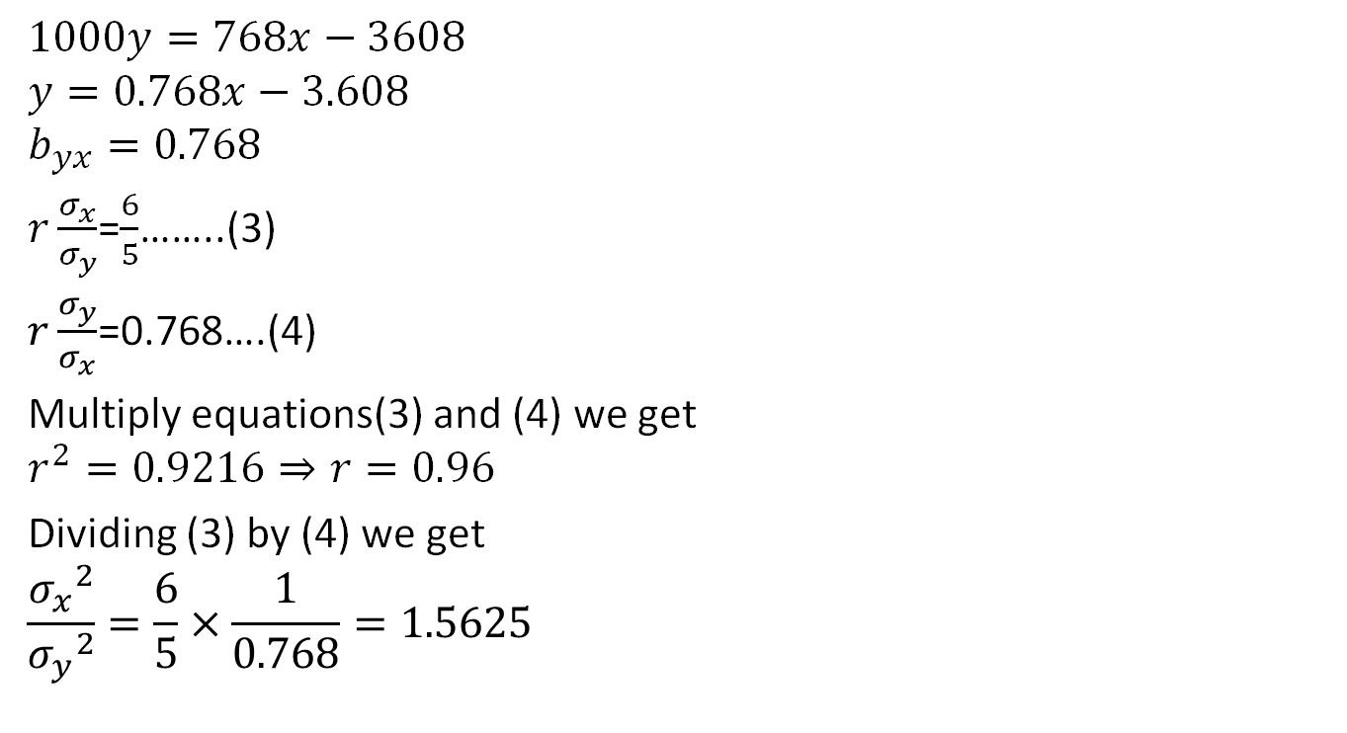
Linear Regression(CO1)
$$1000y=768x−3608$$
$$y=0.768x−3.608$$
$$b_{yx}=0.768$$
$r\frac{σ_{x}}{σ_{y}}$=$\frac{6}{5}$……..(3)
$r\frac{σ_{y}}{σ_{x}}$=0.768….(4)
Multiply equations(3) and (4) we get
$$r^{2}=0.9216⇒r=0.96$$
Dividing (3) by (4) we get
$$\frac{{σ_{x}}^{2}}{{σ_{y}}^{2}}=\frac{6}{5}×\frac{1}{0.768}=1.5625$$

Slide 74
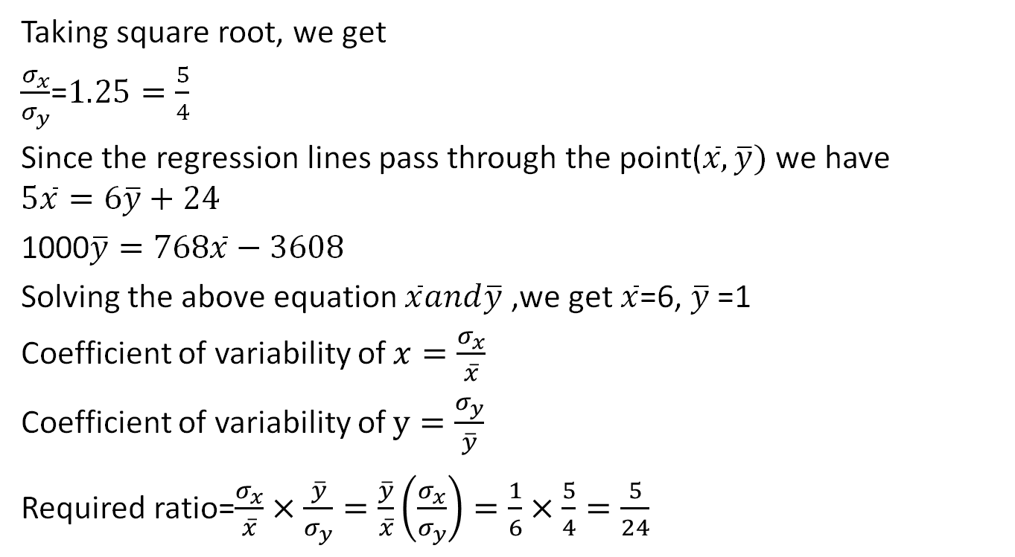
Linear Regression(CO1)
Taking square root, we get
$\frac{σ_{x}}{σ_{y}}$=$1.25=\frac{5}{4}$
Since the regression lines pass through the point($\overline{x},\overline{y})$ we have
$$5\overline{x}=6\overline{y}+24$$
1000$\overline{y}=768\overline{x}−3608$
Solving the above equation $\overline{x}and\overline{y}$ ,we get $\overline{x}$=6, $\overline{y}$ =1
Coefficient of variability of $x=\frac{σ_{x}}{\overline{x}}$
Coefficient of variability of $y=\frac{σ_{y}}{\overline{y}}$
Required ratio=$\frac{σ_{x}}{\overline{x}}×$ $\frac{\overline{y}}{σ_{y}}=\frac{\overline{y}}{\overline{x}}\left(\frac{σ_{x}}{σ_{y}}\right)=\frac{1}{6}×\frac{5}{4}=\frac{5}{24}$

Slide 75
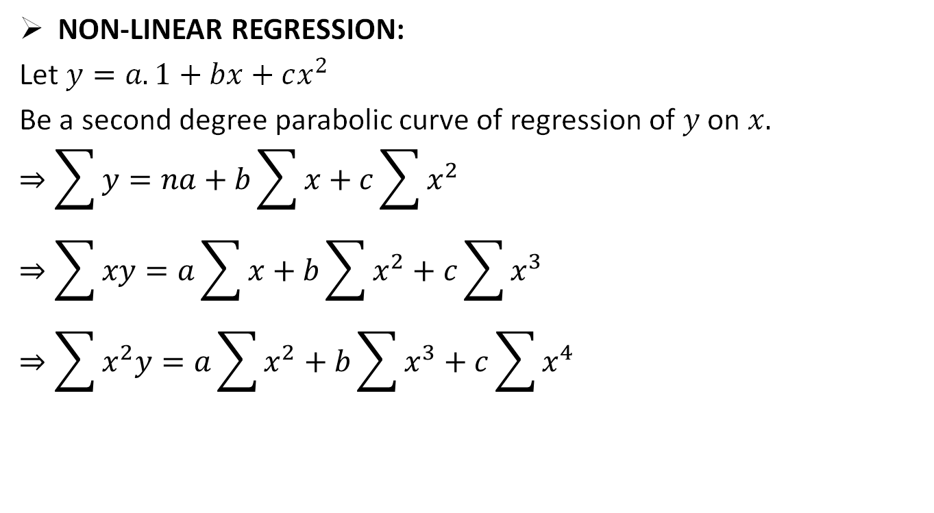
Non-Linear Regression(CO1)
NON-LINEAR REGRESSION:
Let $y=a.1+bx+cx^{2}$
Be a second degree parabolic curve of regression of $y$ on $x.$
$$⇒\sum{y}=na+b\sum{x+c\sum{x^{2}}}$$
$$⇒\sum{xy}=a\sum{x+b\sum{x^{2}}+c}\sum{x^{3}}$$
$$⇒\sum{x^{2}y}=a\sum{x^{2}+b\sum{x^{3}}+c}\sum{x^{4}}$$

Slide 76
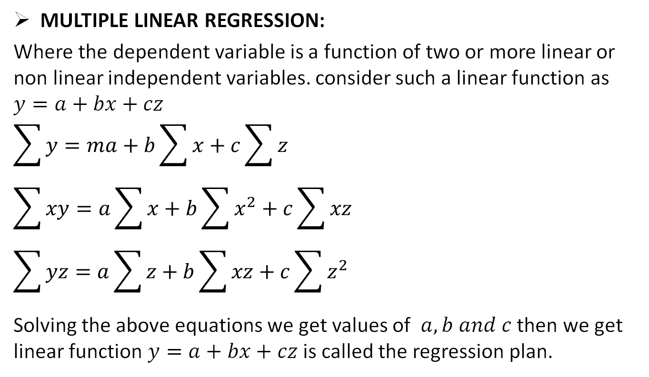
Multiple Linear Regression(CO1)
MULTIPLE LINEAR REGRESSION:
Where the dependent variable is a function of two or more linear or non linear independent variables. consider such a linear function as $y=a+bx+cz$
$$\sum{y}=ma+b\sum{x}+c\sum{z}$$
$$\sum{xy}=a\sum{x}+b\sum{x^{2}}+c\sum{xz}$$
$$\sum{yz}=a\sum{z}+b\sum{xz}+c\sum{z^{2}}$$
Solving the above equations we get values of $a,b and c$then we get linear function $y=a+bx+cz$ is called the regression plan.

Slide 77
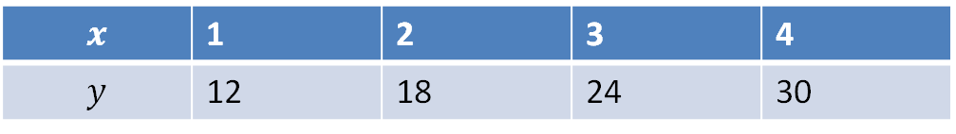
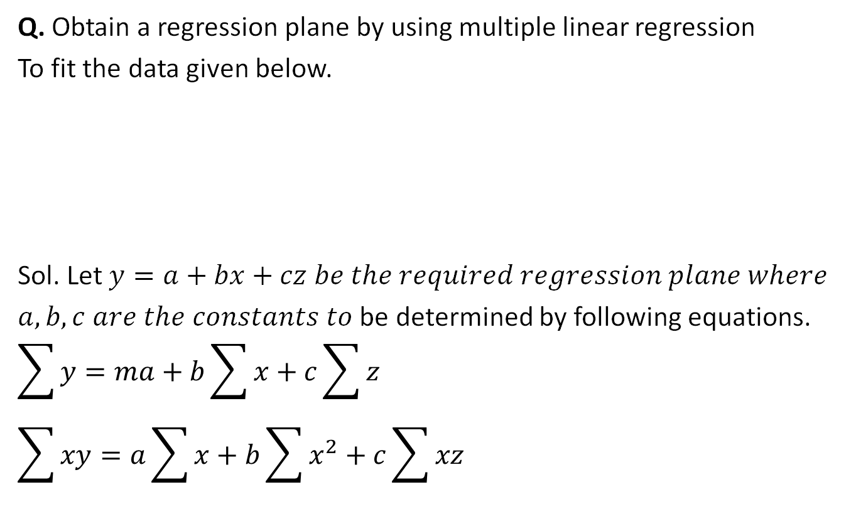
Multiple Linear Regression(CO1)
Q. Obtain a regression plane by using multiple linear regression
To fit the data given below.
Sol. Let $y=a+bx+cz be the required regression plane where$
$a,b,c are the constants to$ be determined by following equations.
$$\sum{y}=ma+b\sum{x}+c\sum{z}$$
$$\sum{xy}=a\sum{x}+b\sum{x^{2}}+c\sum{xz}$$
$$x$$ | 1 | 2 | 3 | 4
$$y$$ | 12 | 18 | 24 | 30
$$z$$ | 0 | 1 | 2 | 3

Slide 78

Multiple Linear Regression(CO1)
$$\sum{yz}=a\sum{z}+b\sum{xz}+c\sum{z^{2}}$$
Here $m=4$ Substitution yields,
84=$4a+10b+6c$
$$240=10a+30b+20c$$
156=6a+20b+14c
$$a=10,b=2,c=4$$
Hence the required regression plane is
$y=10+2x+4z$

Slide 79

Multiple Linear Regression(CO1)

Slide 80
Residual Analysis Identifying significant features
Objective:
In this topic we learn about Residuals which are differences between the one-step-predicted output from the model and the measured output from the validation data set. Thus, residuals represent the portion of the validation data not explained by the model. Residual analysis consists of two tests: the whiteness test and the independence test.
Recap:
Revision of basic statistical approaches.

Slide 81
Residual Analysis Identifying significant features
Residual analysis
The analysis of residuals plays an important role in validating the regression model. If the error term in the regression model satisfies the four assumptions noted earlier, then the model is considered valid. Since the statistical tests for significance are also based on these assumptions, the conclusions resulting from these significance tests are called into question if the assumptions regarding ε are not satisfied.
The ith residual is the difference between the observed value of the dependent variable, yi, and the value predicted by the estimated regression equation, ŷi. These residuals, computed from the available data, are treated as estimates of the model error, ε. As such, they are used by statisticians to validate the assumptions concerning ε. Good judgment and experience play key roles in residual analysis.
Graphical plots and statistical tests concerning the residuals are examined carefully by statisticians, and judgments are made based on these examinations. The most common residual plot shows ŷ on the horizontal axis and the residuals on the vertical axis. If the assumptions regarding the error term, ε, are satisfied, the residual plot will consist of a horizontal band of points. If the residual analysis does not indicate that the model assumptions are satisfied, it often suggests ways in which the model can be modified to obtain better results.

Slide 82
Residual Analysis Identifying significant features
Model building
In regression analysis, model building is the process of developing a probabilistic model that best describes the relationship between the dependent and independent variables. The major issues are finding the proper form (linear or curvilinear) of the relationship and selecting which independent variables to include. In building models it is often desirable to use qualitative as well as quantitative variables.

Slide 83
Feature reduction using AIC, multi-collinearity
Objective:
In this topic we learn about the Akaike information criterion (AIC) which is a mathematical method for evaluating how well a model fits the data it was generated from. In statistics, AIC is used to compare different possible models and determine which one is the best fit for the data.
Recap:
Revision of basic statistical approaches.

Slide 84
Likelihood profiles for 95% confidence intervals
Feature reduction using AIC, multi-collinearity

Slide 85
Mark-recapture example
Residual Analysis Identifying significant features
We tagged 100 fish
Went back a few days later (after mixing etc.)
Recaptured 100 fish
k=5 of the recaptured fish were tagged
We use a Poisson distribution to explore the likelihood of different population sizes (N)
The question is: what is N?
Notes:
So Whenever Probability of Success is Very Small we use Poisson Distribution, It is a Discrete Distribution

Slide 86
What we need
Residual Analysis Identifying significant features
Data: number tagged, number recaptured, tags recaptured
If the population size is N then the proportion tagged is number tagged / N
Predicted number of tags recovered = proportion tagged × number recaptured
Predicted tags recovered is mean (λ) of Poisson: if λ = 1, 2, …, 100 then what is the likelihood of observing 5 recaptures?
Observed data
Model prediction
Notes:
Lambda = Mean Which is constant…

Slide 87
Residual Analysis Identifying significant features
Population size | Num tagged | Prop. tagged | Num recapt. | Pred. tags recapt. λ | Likelihood
500 | 100 | 0.200 | 100 | 20.00 | 0.000
1000 | 100 | 0.100 | 100 | 10.00 | 0.038
1500 | 100 | 0.067 | 100 | 6.67 | 0.140
2000 | 100 | 0.050 | 100 | 5.00 | 0.175
2500 | 100 | 0.040 | 100 | 4.00 | 0.156
3000 | 100 | 0.033 | 100 | 3.33 | 0.122
3500 | 100 | 0.029 | 100 | 2.86 | 0.091
4000 | 100 | 0.025 | 100 | 2.50 | 0.067
4500 | 100 | 0.022 | 100 | 2.22 | 0.049
5000 | 100 | 0.020 | 100 | 2.00 | 0.036
5500 | 100 | 0.018 | 100 | 1.82 | 0.027
6000 | 100 | 0.017 | 100 | 1.67 | 0.020
6500 | 100 | 0.015 | 100 | 1.54 | 0.015
7000 | 100 | 0.014 | 100 | 1.43 | 0.012
7500 | 100 | 0.013 | 100 | 1.33 | 0.009
8000 | 100 | 0.013 | 100 | 1.25 | 0.007
8500 | 100 | 0.012 | 100 | 1.18 | 0.006
9000 | 100 | 0.011 | 100 | 1.11 | 0.005
9500 | 100 | 0.011 | 100 | 1.05 | 0.004
10000 | 100 | 0.010 | 100 | 1.00 | 0.003
Observed data: k = 5
Model prediction: λ

Slide 88
Residual Analysis Identifying significant features
Likelihood profile (k = 5)
This is the likelihood in the right hand column of the previous slide
Likelihood
Population size

Slide 89
Multiple observations
Residual Analysis Identifying significant features
We go out twice more, capturing 100 fish each time, and find 3 that are tagged the second time, and 4 that are tagged the third time

Slide 90
Residual Analysis Identifying significant features
Likelihood profile (k = 5, 3, 4)
Likelihood
Population size

Slide 91
Residual Analysis Identifying significant features
Multiply the three likelihoods together
The result is much narrower and a much smaller number (y-axis on right)
MLE
Likelihood (each data point)
Product of likelihoods
Population size

Slide 92
The likelihood profile
Residual Analysis Identifying significant features
Mark-recapture example only had one parameter (N), so the likelihood profile is just the likelihood
For problems with more than one parameter, fix the parameter of interest at discrete values and maximize the likelihood by searching over all the other parameters
You can use the likelihood profile to calculate a confidence interval
find the two parameter values where the negative log-likelihood is 1.92 units higher than the MLE value

Slide 93
Why 1.92? The likelihood ratio test
Residual Analysis Identifying significant features
The 95% confidence intervals are found where the NLL for a model parameter is more than 1.92 NLL units from the MLE (asymptotically for large sample size, when well behaved, insert further statistical caveats here, etc.)
Notes:
(The value of 1.92 is one-half the 95% critical value for a χ² (pronounced Chi-squared) distribution with one degree of freedom).
A LR of 2 * only increases the probability a small amount. A relatively low likelihood ratio (0.1) will significantly decrease the probability of a disease, given a negative test. A LR of 1.0 means that the test is not capable of changing the post-test probability either up or down and so the test is not worth doing!

Slide 94
Residual Analysis Identifying significant features
Mark-recapture example
MLE
Likelihood
MLE: 2500
95% CI: 1491-4668
NLL
MLE + 1.92 units
MLE
Population size

Slide 95
Model selection
Feature reduction using AIC, multi-collinearity

Slide 96
Readings
Residual Analysis Identifying significant features
Ecological Detective: pp. 152-162
For those interested in reading more:
Hobbs NT & Hilborn R (2006) Alternatives to statistical hypothesis testing in ecology: a guide to self teaching. Ecological Applications 16:5-19

Slide 97
The concept of support
Residual Analysis Identifying significant features
The higher the likelihood (the lower the NLL) the more support the data offer for one hypothesis compared to another hypothesis
The absolute NLL value is meaningless (and in any case depends on which constants is included); the only useful information is the difference in NLL (ΔNLL) among models

Slide 98
Objectives of modelling and implications for model choice
Residual Analysis Identifying significant features
If we want to explore hypotheses: really complex models may be totally appropriate
If we want to do forecasting: very simple models are usually best
If we want to estimate uncertainty and do decision analysis: answer is less clear

Slide 99
Approximation vs. estimation error
Residual Analysis Identifying significant features
If we have too few parameters, we cannot capture the underlying truth very well: error due to approximation
If we have too many parameters we spend too much time fitting to minute vagaries in the data, and can’t estimate the underlying patterns correctly: error due to estimation

Slide 100
Residual Analysis Identifying significant features
Approximation error
Estimation error
Model fit to messy data
Actual truth
Too few parameters to get a good fit to the truth.
Too many parameters, model attempts to fit to every small deviation in the data.

Slide 101
Deciding on the best model
Feature reduction using AIC, multi-collinearity
Need a balance between how well the model fits the data and how many parameters there are in the model
Most widely used methods
Likelihood ratio test (nested models)
Akaike Information Criterion (AIC) for non-nested models

Slide 102
Likelihood ratio test: nested models
Feature reduction using AIC, multi-collinearity
4 parameters
3 parameters
The 2- and 3-parameter models are nested models of the 4-parameter model, obtained by fixing one parameter (to zero)
2 parameters

Slide 103
Likelihood ratio test
Feature reduction using AIC, multi-collinearity
e.g. Model A has more parameters than Model B
For nested models with more parameters, the negative log-likelihood (–lnL) should generally be smaller (better fit).
The likelihood ratio R follows a chi-square distribution with degrees of freedom equal to the difference in parameters between model A and model B.
The –lnL is from the MLE estimate (the best value)

Slide 104
Likelihood ratio test example
Feature reduction using AIC, multi-collinearity
B₁₉₆₅ = K
(r, K, q, σ estimated)
B₁₉₆₅ estimated
(r, K, q, σ estimated)
Model | n pars | lnL
B₁₉₆₅ = K | 4 | 15.56
B₁₉₆₅ free | 5 | 23.78
Difference | 1 | 8.22
Likelihood ratio |  | 16.44
Chi-squared p-value |  | 0.00005
Note: lnL not –lnL (be careful!)
One fewer parameter, one degree of freedom
2(lnL₁-lnL₂) = 2(23.78-15.56)
In Excel, =CHISQ.DIST.RT(16.44,1)
9 Model selection.xlsx: sheet Likelihood ratio test

Slide 105
Problems with likelihood ratio
Residual Analysis Identifying significant features
Only valid for nested models so you cannot compare structurally different models
Cannot compare models with different likelihood functions
Instead we usually use AIC

Slide 106
Akaike Information Criterion (AIC)
Residual Analysis Identifying significant features
An AIC value is calculated for each model of interest. The model with the lowest AIC is the best model.

Slide 107
AIC corrected for small samples AIC_{c}
Residual Analysis Identifying significant features
Negative log-likelihood
Number of model parameters
Correction term
Number of data points
Since the correction term approaches 0 as n increases, you should always use AIC_{c}

Slide 108
Why use AIC_{c}?
Residual Analysis Identifying significant features
Can be used to compare structurally different models (non-nested models)
Can be used for models with different likelihoods (but must include all the constants)
Can be used to find weight of evidence for each model

Slide 109
AIC_{c} weights
Feature reduction using AIC, multi-collinearity
How different the log likelihood of model i is from the best model
The weight assigned each alternative model by AIC_{c}
Wi is the probability that model is best model among those listed
Higher Wi better the model with lower AIC.
Notes:
Delta =Likelihood

Slide 110


Slide 111


Slide 112
Comparing models using AIC_{c}
The Concept Learning Task
The model with the lower AIC_{c} is the better model
Rule of thumb from Burnham and Anderson (2002):
ΔAIC ≤ 2: substantial support (evidence)
4 ≤ ΔAIC ≤ 7: considerably less support
ΔAIC ≥ 10: essentially no support
Classic book: Burnham KP & Anderson DR (2002) Model selection and multi-model inference. Springer, Berlin, Heidelberg, New York.
Notes:
Triangle means Small Change

Slide 113
AIC review
The Concept Learning Task
Model
For model M_{i}
Data (same data for all models)
Number of model parameters
Number of data points
(same for all models)
The very best model
The relative weight to give to competing models

Slide 114
Important note about AIC
The Concept Learning Task
For AIC, AICc and all related information criteria, -lnL is the minimum value of the negative log likelihood, as evaluated at the best parameter estimates for that particular model (i.e. the NLL at the maximum likelihood estimate, MLE)

Slide 115
AIC example
Residual Analysis Identifying significant features
B₁₉₆₅ = K
(r, K, q, σ estimated)
B₁₉₆₅ estimated
(r, K, q, σ estimated)
Biomass
Biomass
Year
Year
Model M_{i} | Params p_{i} |  | NLL | AIC | ΔAIC | exp(-0.5Δ_{i}) | Weight w_{i}
B₁₉₆₅ free | 5 |  | -23.78 | -37.55 | 0.00 | 1.00000 | 0.9993
B₁₉₆₅=K | 4 |  | -15.56 | -23.11 | 14.44 | 0.00073 | 0.0007
Model M_{i} | Params p_{i} | Data n | NLL | AIC_{c} | ΔAIC_{c} | exp(-0.5Δ_{i}) | Weight w_{i}
B₁₉₆₅ free | 5 | 23 | -23.78 | -34.02 | 0.00 | 1.00000 | 0.9986
B₁₉₆₅=K | 4 | 23 | -15.56 | -20.89 | 13.13 | 0.00141 | 0.0014
AIC
AIC_{c}
Usually do not report these columns since only relative values are meaningful

Slide 116
The LRSG model (Lagged recruitment, survival, and growth model)
Feature reduction using AIC, multi-collinearity
This model is introduced to demonstrate how AIC would work with non-nested models
You may skip over the detailed equations

Slide 117
The LRSG model (Lagged recruitment, survival, and growth model)
Feature reduction using AIC, multi-collinearity
Combined survival and somatic growth
Starting conditions, unfished
Catches in year t
Lagged Beverton-Holt recruitment depends on biomass L years ago; L = years from egg deposition until available to fishing
Recruitment assumed to be Beverton-Holt with steepness h

Slide 118
Feature reduction using AIC, multi-collinearity
LRSG model: MSY and B_{MSY}
Biomass at maximum sustainable yield
Parameters of Beverton-Holt stock-recruitment curve
Maximum Sustainable Yield

Slide 119
Feature reduction using AIC, multi-collinearity
Logistic
LRSG
Biomass
Biomass
Year
Year
Model M_{i} |  | Params | NLL | AIC_{c} | ΔAIC_{c} | Weight
Logistic | B₁₉₆₅ free | 5 | -23.78 | -34.02 | 0.00 | 0.9972
Logistic | B₁₉₆₅ = K | 4 | -15.56 | -20.89 | 13.13 | 0.0014
LRSG | B₁₉₆₅ free | 6 | -17.76 | -18.26 | 15.76 | 0.0004
LRSG | B₁₉₆₅ = K | 5 | -16.88 | -20.23 | 13.79 | 0.0010
Conclusion: Best model is logistic with initial stock size free parameter, since it has the lowest AIC_{c}

Slide 120
How to use AIC weight
The Concept Learning Task
AIC weight can be used to combine models for predictions
For example, the four models predicted different B₁₉₈₇ (1523, 1766, 1712, 1553 respectively)
The best multi-model prediction is:
The weight of the first model is so high that the other models have very little influence and are effectively ignored

Slide 121
AIC and different likelihoods
The Concept Learning Task
AIC can be used to compare models with different likelihood functions, provided all the constants are included in the likelihoods
Constant if σ known
and not estimated
Always
constant

Slide 122
Important note for nested models
The Concept Learning Task
For nested models, a model with one more parameter will always have a lower NLL
And therefore the AIC of the more complicated model will always be within 2 units of the less complicated model (because of the +2p_{i} term)
The more complicated model should therefore only be included in model averaging if its AIC is better than the less complicated model

Slide 123
Key points on model selection
The Concept Learning Task
Appropriate model depends on use
Methods
Likelihood ratio for nested models
AIC_{c} for different models
AIC_{c} for models with different likelihoods provided all the constants like sqrt(2π)are included
Issues
Are likelihoods correct?
Likelihood ratio and AIC_{c} are developed from theory about model fit, not uncertainty

Slide 124
Bayes Information Criterion, BIC
Feature reduction using AIC, multi-collinearity
AICc tends to prefer more complex models that overfit the data. An alternative is BIC.
Number of model parameters
Number of data points
Model M_{i} |  | Params | NLL | BIC | ΔBIC
Logistic | B₁₉₆₅ free | 5 | -23.78 | -31.88 | 0.00
Logistic | B₁₉₆₅ = K | 4 | -15.56 | -18.57 | 13.30
LSRG | B₁₉₆₅ free | 6 | -17.76 | -16.70 | 15.17
LSRG | B₁₉₆₅ = K | 5 | -16.88 | -18.09 | 13.79

Slide 125
Choosing a Criterion
The Concept Learning Task
Options: R², LRT, other approaches
Criteria: AIC, AICc, BIC, CAIC,
CIC, DIC, EIC, FIC, GIC, HIC,
ICOMP, JIC, KIC, NIC, OIC,
PIC, QIC, QAIC, RIC, SIC,
TIC, TAIC, WIC, YIC, ZIC,
Bayes factor, Bayesian p-vals,
Cross-validation
Notes:
Still available: LIC, MIC, UIC, VIC

Slide 126

Aspects of Multiple Regression Modeling
Multi-collinearity
Multicollinearity
Variance Inflation Factor (VIF)

Slide 127

Aspects of Multiple Regression Modeling
The Concept Learning Task
Multicollinearity
The presence of multicollinearity can be detected in several ways. Two of the more easily understood of these are:

Slide 128
Non-normality and Hetero scedasticity
Objective:
In this topic we learn about homoscedasticity which means “having the same scatter.” For it to exist in a set of data, the points must be about the same distance from the line, as shown in the picture above. The opposite is heteroscedasticity (“different scatter”), where points are at widely varying distances from the regression line.
Recap:
Revision of basic statistical approaches.

Slide 129

Non-normality and Hetero scedasticity

Slide 130

Non-normality and Hetero scedasticity

Slide 131

Non-normality and Hetero scedasticity

Slide 132

Non-normality and Hetero scedasticity

Slide 133

Non-normality and Hetero scedasticity

Slide 134

Non-normality and Hetero scedasticity

Slide 135

Non-normality and Hetero scedasticity

Slide 136

Non-normality and Hetero scedasticity

Slide 137

Non-normality and Hetero scedasticity

Slide 138

Non-normality and Hetero scedasticity

Slide 139

Non-normality and Hetero scedasticity

Slide 140

Non-normality and Hetero scedasticity

Slide 141

Non-normality and Hetero scedasticity

Slide 142

Non-normality and Hetero scedasticity

Slide 143
Hypothesis testing of Regression Model
Objective:
In this topic we learn about Hypothesis testing which is used to confirm if our beta coefficients are significant in a linear regression model. Every time we run the linear regression model, we test if the line is significant or not by checking if the coefficient is significant
Recap:
Revision of basic statistical approaches.

Slide 144
Simple Linear Regression
The Concept Learning Task
The case of simple linear regression considers a single regressor or predictor x and a dependent or response variable Y.
The expected value of Y at each level of x is a random variable:
We assume that each observation, Y, can be described by the model

Slide 145

Simple Linear Regression
The Concept Learning Task
Suppose that we have n pairs of observations (x₁, y₁), (x₂, y₂), …, (x_{n}, y_{n}).
Figure 11-3 Deviations of the data from the estimated regression model.

Slide 146


Simple Linear Regression
The Concept Learning Task
The method of least squares is used to estimate the parameters, β₀ and β₁ by minimizing the sum of the squares of the vertical deviations in Figure 11-3.
Figure 11-3 Deviations of the data from the estimated regression model.

Slide 147


Simple Linear Regression
The Concept Learning Task
Using Equation 11-2, the n observations in the sample can be expressed as
The sum of the squares of the deviations of the observations from the true regression line is

Slide 148

11-2 Simple Linear Regression
The Concept Learning Task

Slide 149

11-2 Simple Linear Regression
The Concept Learning Task

Slide 150



11-2 Simple Linear Regression
The Concept Learning Task
Definition

Slide 151


11-2 Simple Linear Regression
The Concept Learning Task

Slide 152


11-2 Simple Linear Regression
The Concept Learning Task
Notation

Slide 153


11-2 Simple Linear Regression
The Concept Learning Task
Example 11-1

Slide 154


11-2 Simple Linear Regression
The Concept Learning Task
Example 11-1

Slide 155

11-2 Simple Linear Regression
The Concept Learning Task
Example 11-1
Figure 11-4 Scatter plot of oxygen purity y versus hydrocarbon level x and regression model ŷ = 74.20 + 14.97x.

Slide 156

11-2 Simple Linear Regression
The Concept Learning Task
Example 11-1

Slide 157



The Concept Learning Task

Slide 158

11-2 Simple Linear Regression
The Concept Learning Task
Estimating σ²
The error sum of squares is
It can be shown that the expected value of the error sum of squares is E(SS_{E}) = (n – 2)σ².

Slide 159


11-2 Simple Linear Regression
The Concept Learning Task
Estimating σ²
An unbiased estimator of σ² is
where SS_{E} can be easily computed using

Slide 160


11-3 Properties of the Least Squares Estimators
The Concept Learning Task
Slope Properties
Intercept Properties

Slide 161


11-4 Hypothesis Tests in Simple Linear Regression
The Concept Learning Task
11-4.1 Use of t-Tests
Suppose we wish to test
An appropriate test statistic would be

Slide 162


11-4 Hypothesis Tests in Simple Linear Regression
The Concept Learning Task
11-4.1 Use of t-Tests
The test statistic could also be written as:
We would reject the null hypothesis if

Slide 163


11-4 Hypothesis Tests in Simple Linear Regression
The Concept Learning Task
11-4.1 Use of t-Tests
Suppose we wish to test
An appropriate test statistic would be

Slide 164
11-4 Hypothesis Tests in Simple Linear Regression
The Concept Learning Task
11-4.1 Use of t-Tests
We would reject the null hypothesis if

Slide 165

11-4 Hypothesis Tests in Simple Linear Regression
The Concept Learning Task
11-4.1 Use of t-Tests
An important special case of the hypotheses of Equation 11-18 is
These hypotheses relate to the significance of regression.
Failure to reject H₀ is equivalent to concluding that there is no linear relationship between x and Y.

Slide 166





11-4 Hypothesis Tests in Simple Linear Regression
The Concept Learning Task
Figure 11-5 The hypothesis H₀: β₁ = 0 is not rejected.

Slide 167





11-4 Hypothesis Tests in Simple Linear Regression
The Concept Learning Task
Figure 11-6 The hypothesis H₀: β₁ = 0 is rejected.

Slide 168

11-4 Hypothesis Tests in Simple Linear Regression
The Concept Learning Task
Example 11-2

Slide 169
The Concept Learning Task
11-4.2 Analysis of Variance Approach to Test Significance of Regression
The analysis of variance identity is
Symbolically,

Slide 170
11-4 Hypothesis Tests in Simple Linear Regression
The Concept Learning Task
11-4.2 Analysis of Variance Approach to Test Significance of Regression
If the null hypothesis, H₀: β₁ = 0 is true, the statistic
follows the F_{1,n-2} distribution and we would reject if f₀ > f_{α,1,n-2}.

Slide 171


11-4 Hypothesis Tests in Simple Linear Regression
The Concept Learning Task
11-4.2 Analysis of Variance Approach to Test Significance of Regression
The quantities, MS_{R} and MS_{E} are called mean squares.
Analysis of variance table:

Slide 172

11-4 Hypothesis Tests in Simple Linear Regression
The Concept Learning Task
Example 11-3

Slide 173


11-4 Hypothesis Tests in Simple Linear Regression
The Concept Learning Task

Slide 174
Confidence intervals of Slope, R-square and goodness of fit
Objective:
In this topic we learn about Each confidence interval which is calculated using an estimate of the slope plus and/or minus a quantity that represents the distance from the mean to the edge of the interval. For two-sided confidence intervals, this distance is sometimes called the precision, margin of error, or half-width.
Recap:
Revision of basic statistical approaches.

Slide 175
11-5 Confidence Intervals
The Concept Learning Task
11-5.1 Confidence Intervals on the Slope and Intercept
Definition

Slide 176

11-6 Confidence Intervals
The Concept Learning Task
Example 11-4

Slide 177
11-5 Confidence Intervals
The Concept Learning Task
11-5.2 Confidence Interval on the Mean Response
Definition

Slide 178

11-5 Confidence Intervals
The Concept Learning Task
Example 11-5

Slide 179

11-5 Confidence Intervals
The Concept Learning Task
Example 11-5

Slide 180

11-5 Confidence Intervals
The Concept Learning Task
Example 11-5

Slide 181
11-5 Confidence Intervals
The Concept Learning Task
Example 11-5
Figure 11-7 Scatter diagram of oxygen purity data from Example 11-1 with fitted regression line and 95 percent confidence limits on μ_{Y|x0}.

Slide 182
Influential Observations – Leverage.
The Concept Learning Task
Objective:
In this topic we learn about The leverage of an observation which is based on how much the observation's value on the predictor variable differs from the mean of the predictor variable. The greater an observation's leverage, the more potential it has to be an influential observation.
Recap:
Revision of basic statistical approaches.

Slide 183

11-6 Prediction of New Observations
The Concept Learning Task
If x₀ is the value of the regressor variable of interest,
is the point estimator of the new or future value of the response, Y₀.

Slide 184
11-6 Prediction of New Observations
The Concept Learning Task
Definition

Slide 185

11-6 Prediction of New Observations
The Concept Learning Task
Example 11-6

Slide 186

11-6 Prediction of New Observations
The Concept Learning Task
Example 11-6

Slide 187
11-6 Prediction of New Observations
The Concept Learning Task
Example 11-6
Figure 11-8 Scatter diagram of oxygen purity data from Example 11-1 with fitted regression line, 95% prediction limits (outer lines) , and 95% confidence limits on μ_{Y|x0}.

Slide 188
Daily Quiz
What do you understand by predictive analytics?
How does predictive analysis work?
What is the purpose of predictive analytics?
What are the benefits of predictive analytics?
What is a predictive algorithm?
Does using analytics benefit the companies?
What is regression model?
Define Correlation ?
What is heteroscedastic approach?
Define multiple regression with example?

Slide 189
Weekly/monthly/Unit Wise Assignment.
Assignment
1. What are the differences between supervised and unsupervised learning?
2. How is logistic regression done?
3. Differentiate between structured and unstructured datasets?
4. Mention What Is The Responsibility Of A Data Analyst?
5. What Is Required To Become A Data Analyst?
6. Mention What Are The Various Steps In An Analytics Project?
7. Mention What Is multicollinearity?
8. List Out Some Of The Best Practices For Data Cleaning?
9. List Of Some Best Tools That Can Be regression analysis?
10. Mention What Is The Difference Between Data Mining And Data Profiling?

Slide 190
Faculty Video Links, You tube & NPTEL Video Links and Online Courses Details
You Tube video
(1) Predictive Analytics Tutorial | Linear Regression in Python | Logistic Regression | Great Learning - YouTube
(2) Multiple Regression Analysis: Hypothesis Tests - YouTube
(3) Mod-06 Lec-28 Goodness of Fit - YouTube

Slide 191
MCQ unit wise/weekly
1. The IBM _________ analytics appliances combine high-capacity storage for Big Data with a massivelyparallel processing platform for high-performance computing.
a) Watson
b) Netezza
c) InfoSight
d) LityxEQ
2. ______ is an integrated hosted analytics platform for marketing insights, predictive models, andmarketing optimization”
a) LityxEQ
b) WatSon
c) LityxIQ
d) InfoSight
3. ________ is rapidly being adopted for computing descriptive and query types of analytics on Big data.
a) EDR
b) Hadoop

Slide 192
MCQ unit wise/weekly
4. _________ involves predicting a response with meaningful magnitude, such as quantity sold, stockprice, or return on investment.
a) Regression
b) Summarization
c) Clustering
d) Classification
5. Which of the following involves predicting a categorical response?
a) Regression
b) Summarization
c) Clustering
d) Classification

Slide 193
Glossary Questions
1. a)Data Cleaning b) Data Transformation c) Data Reduction d) Data Integration i. __________involves combining data residing in different sources and providing users with a unified view of them. ii.____________is the process of converting data from one format to another. iii.___________ is the transformation of numerical or alphabetical digital information derived empirically or experimentally into a corrected, ordered, and simplified form. iv._______is the process of fixing or removing incorrect, corrupted, incorrectly formatted, duplicate, or incomplete data within a dataset.
2. a) Relational database b) Transactional database c) Data Warehouse d) Spatial database i. ___________ is a database management system (DBMS) that can reverse or scale back a database transaction or activity if it isn't performed correctly. ii.____________is a database optimized for storing and querying data that represents objects defined in a geometric space. iii._________ is a type of database that stores and provides access to data points that are related to one another. iv.____________is a system used for reporting and data analysis and is considered a core component of business intelligence.
3. a) Statistics b) Visualization c) Data Mining d) Clustering i. ___________is a process of extracting and discovering patterns in large data sets involving methods at the intersection of machine learning, statistics. ii.__________s the task of grouping a set of objects in such a way that objects in the same group are more similar to each other than to those in other groups. iii._______is the graphical representation of information and data. iv.________ is the science concerned with developing and studying methods for collecting, analysing, interpreting and presenting empirical data.

Slide 194

Semester Paper

Slide 195

Semester Paper

Slide 196

Semester Paper

Slide 197

Semester Paper

Slide 198
Expected Questions for University Exam
1. What Is A Recommender System?
2. Compare Sas, R And Python Programming?
3. Explain The Various Benefits Of R Language?
4. How Do Data Scientists Use Statistics?
5. What Is Logistic Regression?
6. Why Data Cleansing Is Important In Data Analysis?
7. Describe Univariate, Bivariate And Multivariate Analysis.?
8. How Machine Learning Is Deployed In Real World Scenarios?
9. What Are Some Of The Statistical Methods That Are Useful For Data-analyst?
10. Explain What Is The Criteria For A Good Data Model?

Slide 199
References
Text books
1. Dean Abbott ,“Applied Predictive Analytics Principles and Techniques for the Professional DataAnalyst” , Wiley.
2. “Fundamentals of Machine Learning for Predictive Data Analytics” By John D. Kelleher, Brian Mac Namee and Aoife D'Arcy
3. Predictive & Advanced Analytics (IBM ICE Publication)
Reference Books
1. “An Introduction to Statistical Learning: with Applications in R” by James, Witten, Hastie and Tibshirani, Springer, 1st. Edition, 2013.
2.“R for Everyone: Advanced Analytics and Graphics” by Lander, J., Addison-Wesley Data & Analytics Series, 1 edition, 2013.
3.Sandeep Rakshit, R for Beginners, McGraw Hill (2017).

Slide 200
Recap
This unit provide us fundamentals domain of predictive analytics and its latest trends in industry as per data standards.
In this unit we are also benefitted with the knowledge of different types of data and very important is the implementation of machine learning and also through the concept model building which is used in industry prospects.
This unit will impart us with knowledge of business analytics and tolls used in data science.

Slide 201
CONTENT
Thank You

